Slide 1



Building Automation with Failure Tolerance
Automação de Edifícios com Tolerância a Falhas
Bernardo Ferreira
Supervisor: Prof. Dr. João Paulo Barraca
Co-supervisor: Mestre Nuno Lourenço
Examiner: Prof. Dr. Jorge Sá Silva
Dissertação de Mestrado Integrado em Engenharia de Computadores e Telemática
Aveiro, 20 Dezembro de 2017

Slide 2
Outline
Motivation & Objectives
Framework
SmartLighting
Project
Implementation
Evaluation & Results
Conclusion & Future Work
Notes:
Estrutura
Introdução teorica
E finalmente as conclusoes e trabalho futuro

Slide 3
Motivation & Objectives
Motivation & Objectives
Framework
SmartLighting
Project
Implementation
Evaluation & Results
Conclusion & Future Work

Slide 4
Problems
Motivation & Objectives
Building Automation with Failure Tolerance
Bernardo Ferreira
Non-residential buildings take a huge part of the worldwide energy consumption;
Building Automation Systems solutions are very expensive;
Most of the solutions are proprietary and therefore, the hardware, installation and management is controlled by the same vendor.
Motivation & Objectives
Framework
SmartLighting Project
Implementation
Evaluation &
Results
Conclusion &
Future Work
Notes:
Nos dias que correm e com base em varios estudos cncluiu-se que os edificios não residencias consomem uma grande quantidade de energia.
Um dos grandes problemas de soluçoes para smart buildings é o preço e serem proprietarios, ou seja a empresa controla desde o hardware à instalação e gestão.

Slide 5
Motivation
Motivation & Objectives
Building Automation with Failure Tolerance
Bernardo Ferreira
IT2 building lack the support for intelligence and automation systems;
Reduce operational costs while increasing comfort of IT2 building occupants.
Motivation & Objectives
Framework
SmartLighting Project
Implementation
Evaluation &
Results
Conclusion &
Future Work
Notes:
Falta de uma solução de automaç\ao da climatizaç\ao, luzes etcc no IT2
E tambem a redução dos custos operacionais e aumento do conforto dos seus ocupantes.

Slide 6
Objectives
Motivation & Objectives
Building Automation with Failure Tolerance
Bernardo Ferreira
Enhance SmartLighting project with new features:
Remove single points of failure;
Detect system failures and react fast to resolve them;
Empower gateways with event processing capabilities.
Motivation & Objectives
Framework
SmartLighting Project
Implementation
Evaluation &
Results
Conclusion &
Future Work
Notes:
Os objectivos para este trabalho foram:
Melhorar o projeto SmartLighting removendo pontos unicos de falha
Deteção automatica de falhas nos componentes e capacidade para as resolver
Adicionar às gateways capacidade de processamento de eventos.

Slide 7
Framework
Motivation & Objectives
Framework
SmartLighting
Project
Implementation
Evaluation & Results
Conclusion & Future Work
Notes:
Breve introdução teorica

Slide 8
Building Automation Systems
Framework
Building Automation with Failure Tolerance
Bernardo Ferreira
Automate HVAC, Lighting etc.;
Intelligent energy management;
Main goal: Lower energy costs and reduce building’s sector energy footprint;
Main market competitors: Honeywell, Siemens, Schneider Electric, Johnson Controls;
Protocols: KNX, BACnet, LonWorks, EnOcean.
Motivation & Objectives
Framework
SmartLighting Project
Implementation
Evaluation &
Results
Conclusion &
Future Work
Notes:
Automação de edificios.
Automatizar a climatização, iluminação etc, fazendo uma gestao inteligente da energia de modo a reduzir os custos operacionais dos edificios
Alguns protocolos usados
Mais recentemente o fenomeno da internet das coisas tem vindo a revolucionar o mercado, tendo estes vendedores de se adaptar.

Slide 9
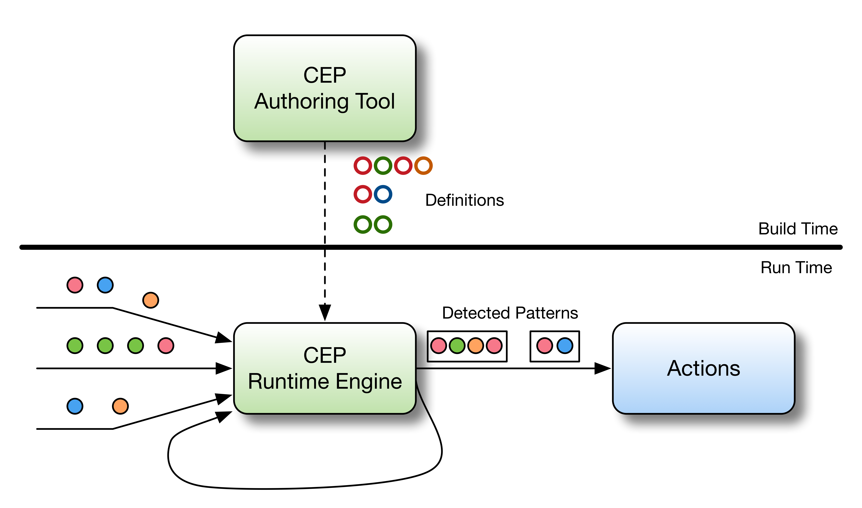
Complex Event Processing
Framework
Building Automation with Failure Tolerance
Bernardo Ferreira
Derive conclusions from tracking and processing streams of information in real-time;
Drools Fusion, Esper, WSO2 Siddhi.
Motivation & Objectives
Framework
SmartLighting Project
Implementation
Evaluation &
Results
Conclusion &
Future Work
Notes:
Correlacionar grandes quantidades de dados de modo a produzir respostas baseadas em regrass e padroes pre definidas ou eventos passados

Slide 10
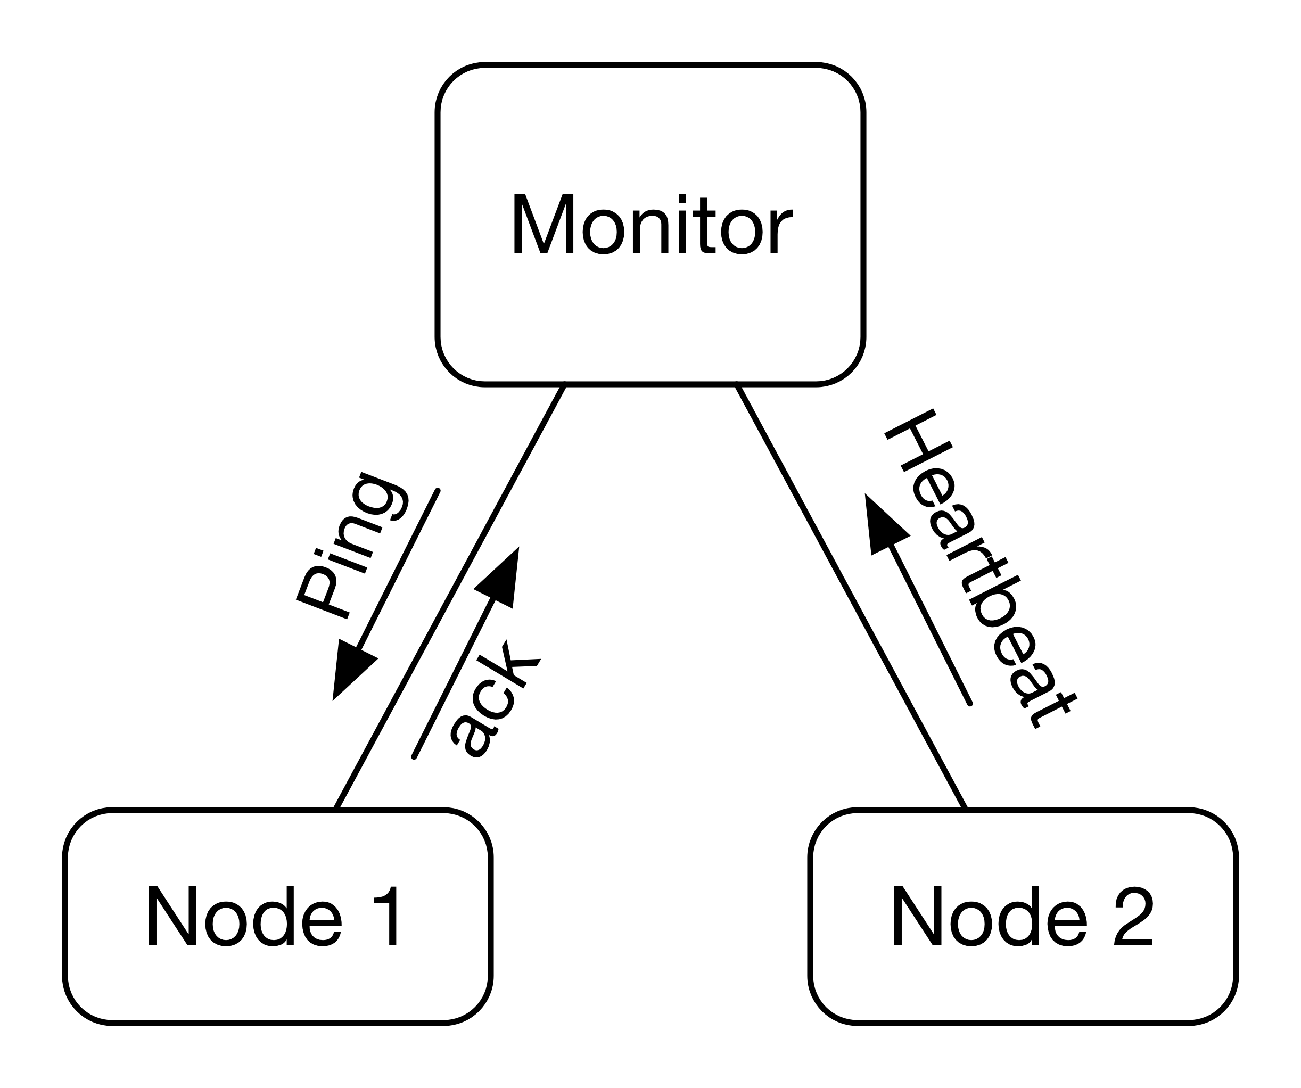
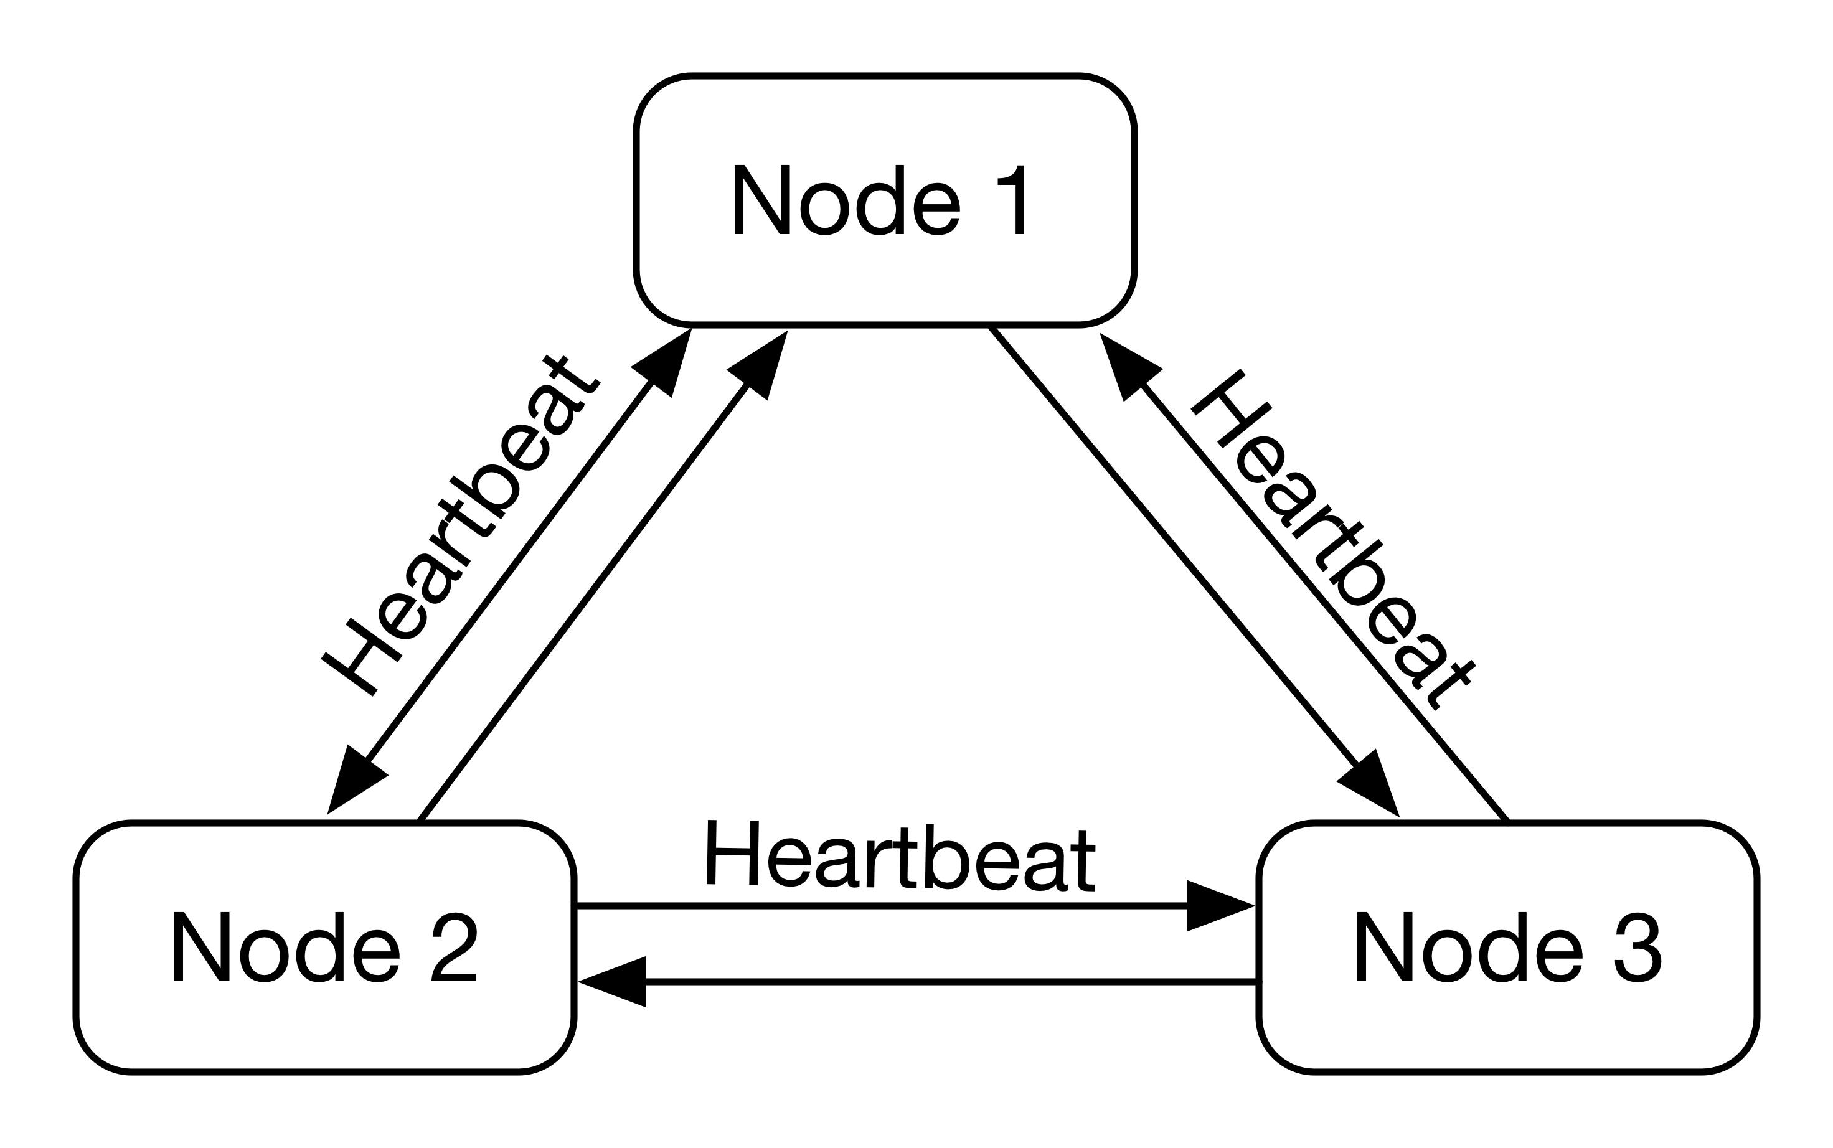
Fault Detection Techniques
Framework
Building Automation with Failure Tolerance
Bernardo Ferreira
Ping messages or Heartbeat messages;
Centralized or distributed approach.
Centralized fault detection
Distributed fault detection using Heartbeat
Motivation & Objectives
Framework
SmartLighting Project
Implementation
Evaluation &
Results
Conclusion &
Future Work
Notes:
mudar imagens

Slide 11
SmartLighting Project
Motivation & Objectives
Framework
SmartLighting
Project
Implementation
Evaluation & Results
Conclusion & Future Work

Slide 12
Overview
SmartLighting Project
Building Automation with Failure Tolerance
Bernardo Ferreira
Aims to create a smart environment in IT2 building;
Automation of HVAC and lighting infrastructure;
Act in real-time based on collected data;
Allow setting up rules based on user’s preferences;
Building management platform
Moreira, H. “Sensor Data Integration and Management of Smart Environments.” 2016.
Motivation & Objectives
Framework
SmartLighting Project
Implementation
Evaluation &
Results
Conclusion &
Future Work
Notes:
Atuar em tempo real aos dados lidos nos sensores
Disponibilizar a criação de regras de automação aos utilizadores e gestores do edificio

Slide 13
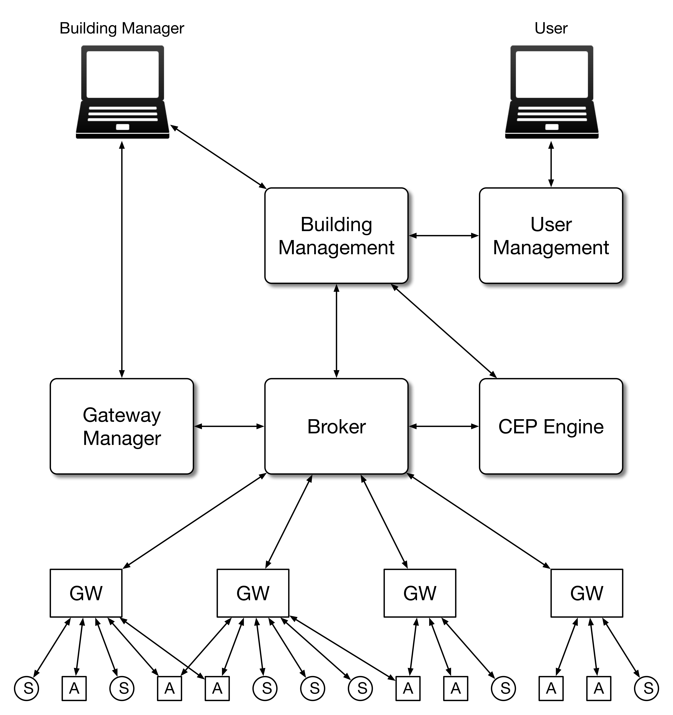
Global Architecture
SmartLighting Project
Building Automation with Failure Tolerance
Bernardo Ferreira
Motivation & Objectives
Framework
SmartLighting Project
Implementation
Evaluation &
Results
Conclusion &
Future Work

Slide 14
Global Architecture
SmartLighting Project
Building Automation with Failure Tolerance
Bernardo Ferreira
Building Management:
User friendly platform;
Rule management;
Distribution of devices in a virtual building’s schema.
Motivation & Objectives
Framework
SmartLighting Project
Implementation
Evaluation &
Results
Conclusion &
Future Work

Slide 15
Global Architecture
SmartLighting Project
Building Automation with Failure Tolerance
Bernardo Ferreira
CEP Engine:
High performance WSO2 CEP Engine;
Process sensor events based on the implemented rules.
Motivation & Objectives
Framework
SmartLighting Project
Implementation
Evaluation &
Results
Conclusion &
Future Work

Slide 16
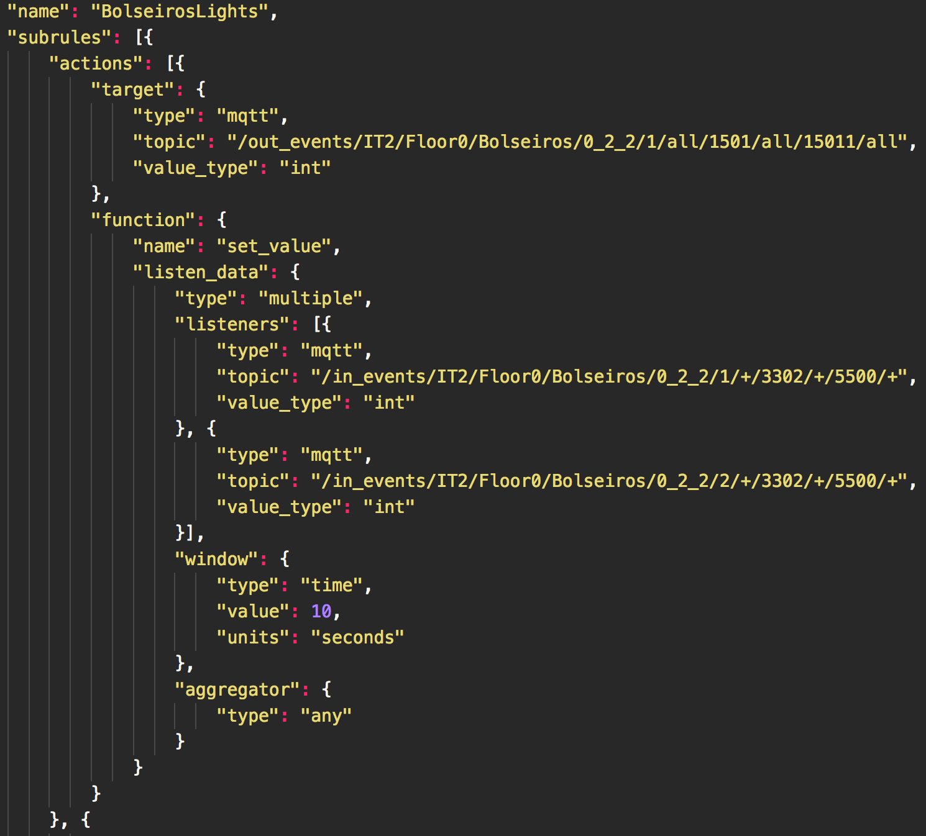
Rules Standard
SmartLighting Project
Building Automation with Failure Tolerance
Bernardo Ferreira
Sensor 1
Light 1
Light 1
Sensor 2
Motivation & Objectives
Framework
SmartLighting Project
Implementation
Evaluation &
Results
Conclusion &
Future Work
Notes:
caracteriza a localizaçao do dispositivo no edificio

Slide 17
Global Architecture
SmartLighting Project
Building Automation with Failure Tolerance
Bernardo Ferreira
Message Broker:
Message-oriented middleware;
MQTT Protocol;
Publish/Subscribe model;
Motivation & Objectives
Framework
SmartLighting Project
Implementation
Evaluation &
Results
Conclusion &
Future Work
Notes:
Broker de mensagens
Elemento por onde todos os componentes comunicam
Utiliza o protocolo MQTT
Utiliza metodo de Publish/Subscribe

Slide 18
Global Architecture
SmartLighting Project
Building Automation with Failure Tolerance
Bernardo Ferreira
Gateway Manager:
Rules and devices distribution;
Awareness of Gateway’s state;
Resolve Gateway’s failures.
Motivation & Objectives
Framework
SmartLighting Project
Implementation
Evaluation &
Results
Conclusion &
Future Work

Slide 19
Global Architecture
SmartLighting Project
Building Automation with Failure Tolerance
Bernardo Ferreira
Gateway:
Convert sensor events to understandable messages and vice-versa;
Process events using a lightweight CEP engine.
Motivation & Objectives
Framework
SmartLighting Project
Implementation
Evaluation &
Results
Conclusion &
Future Work

Slide 20
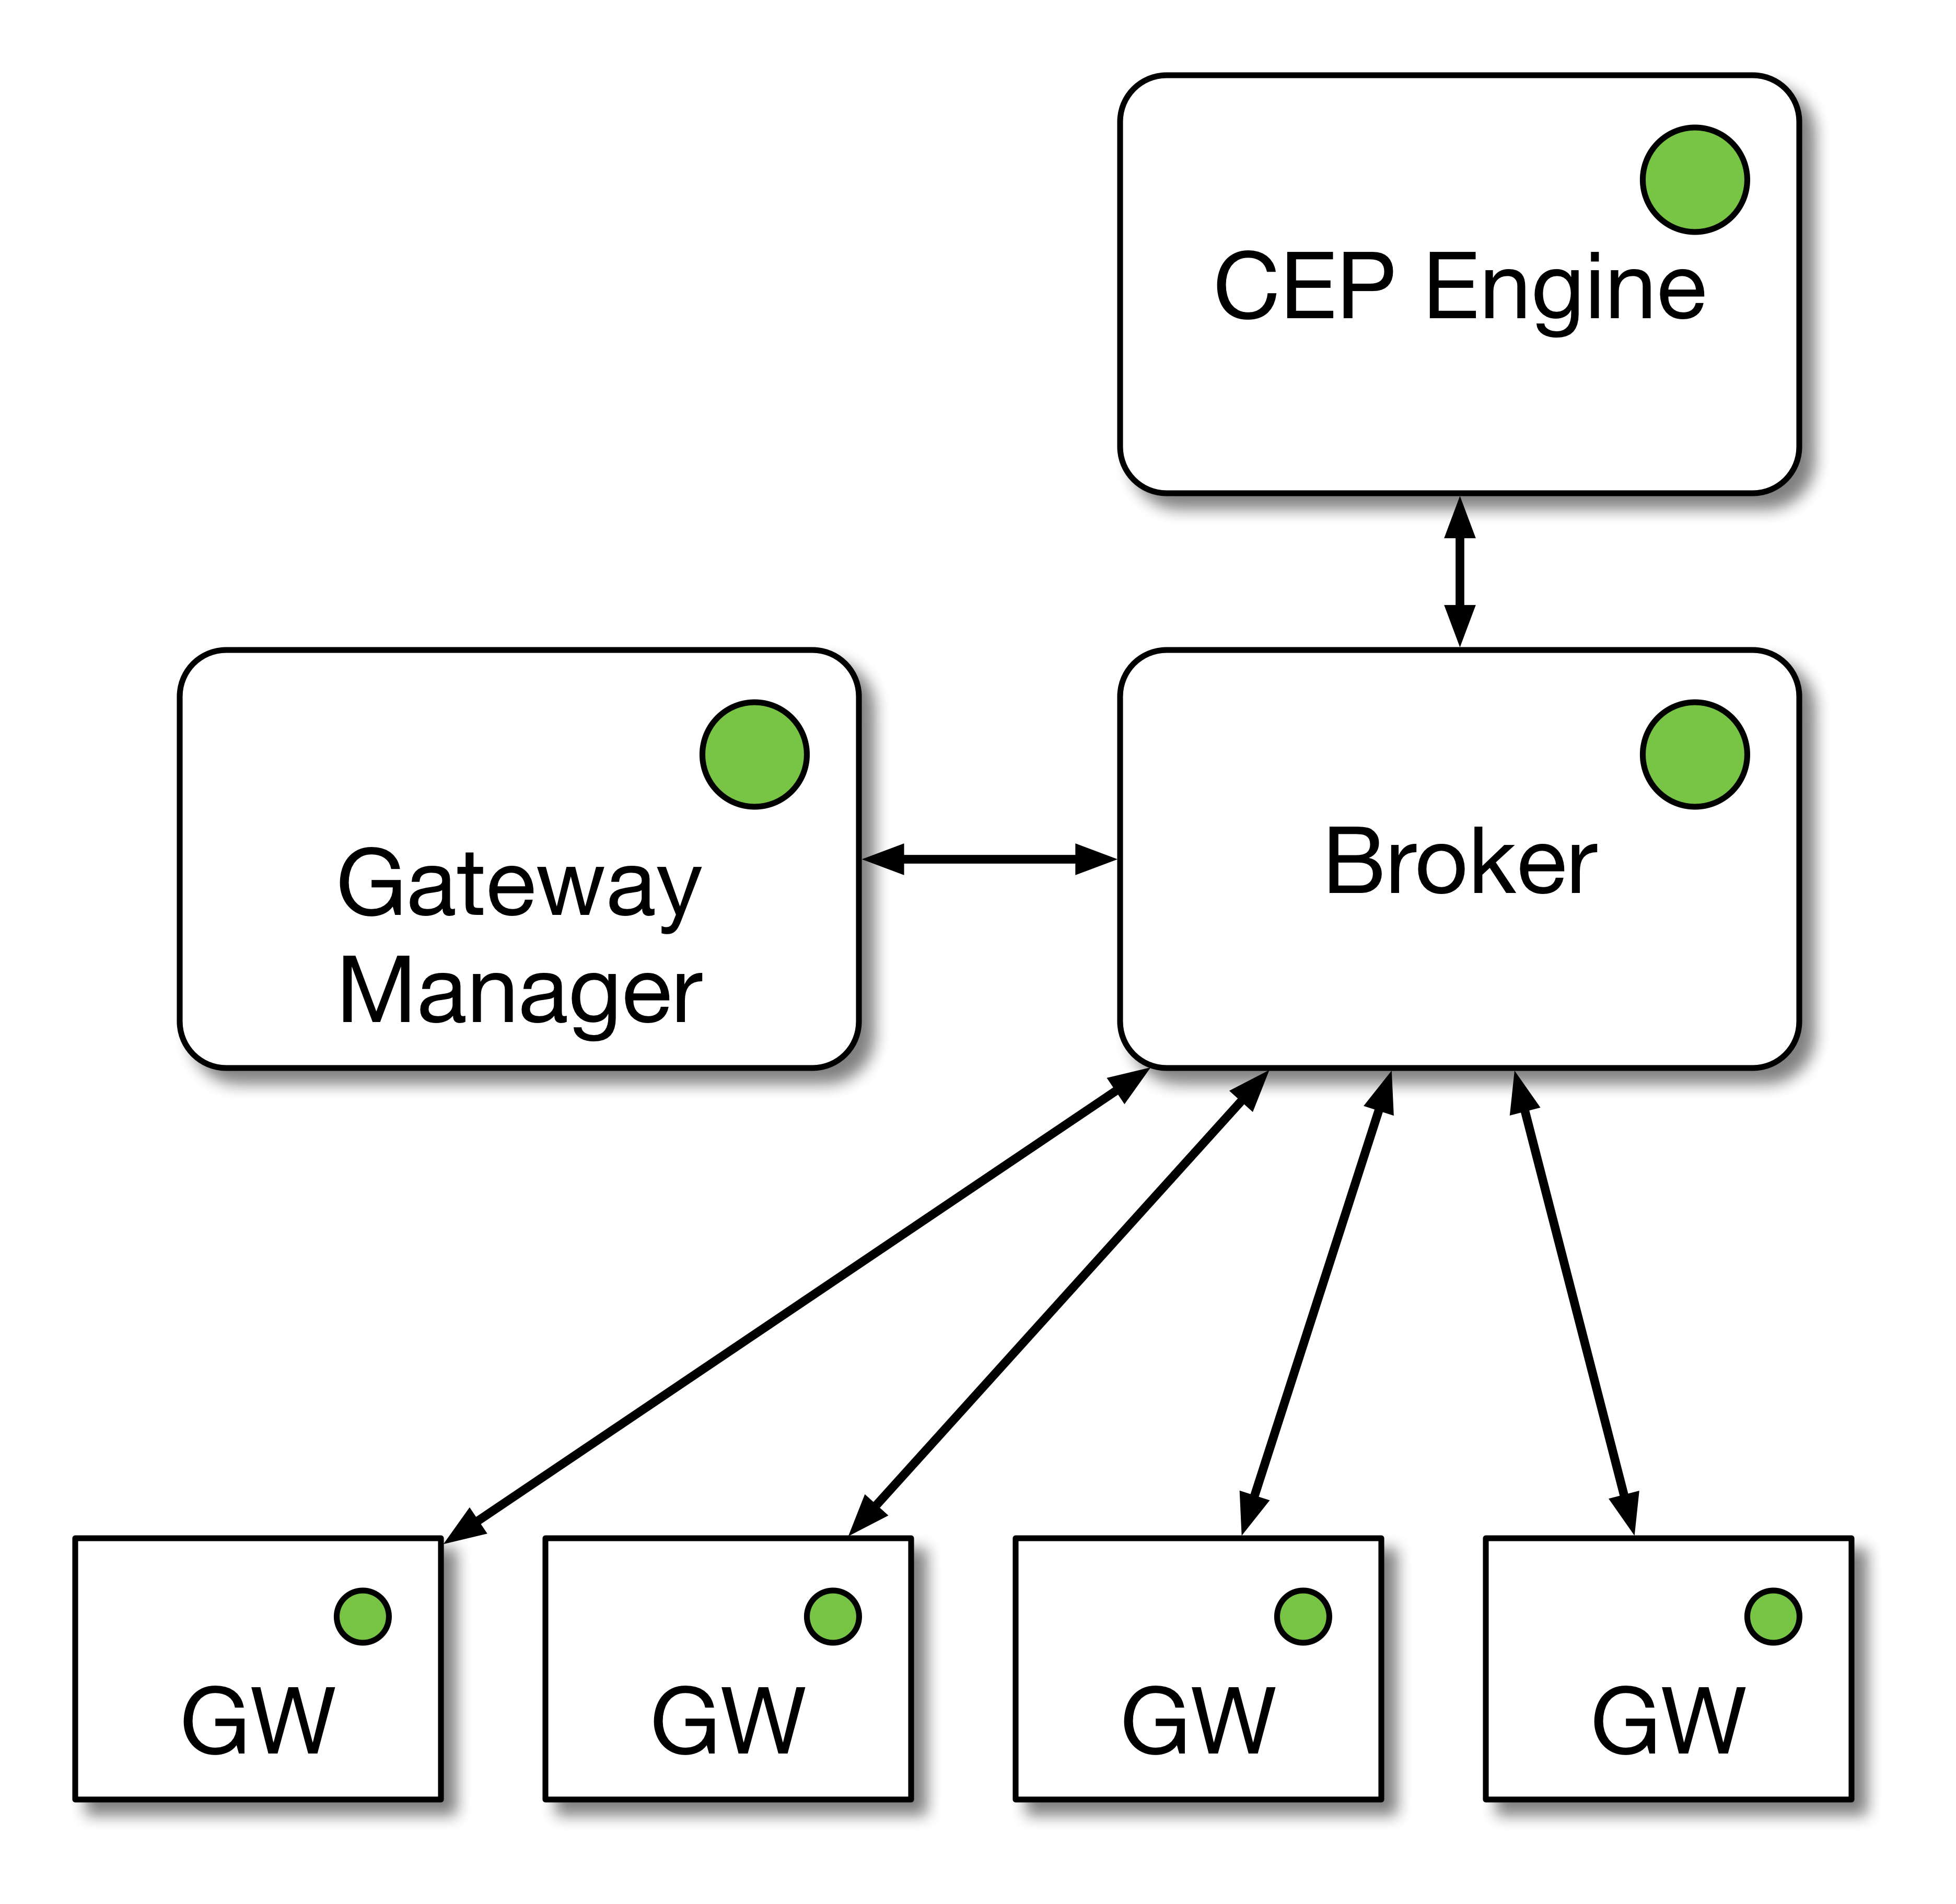
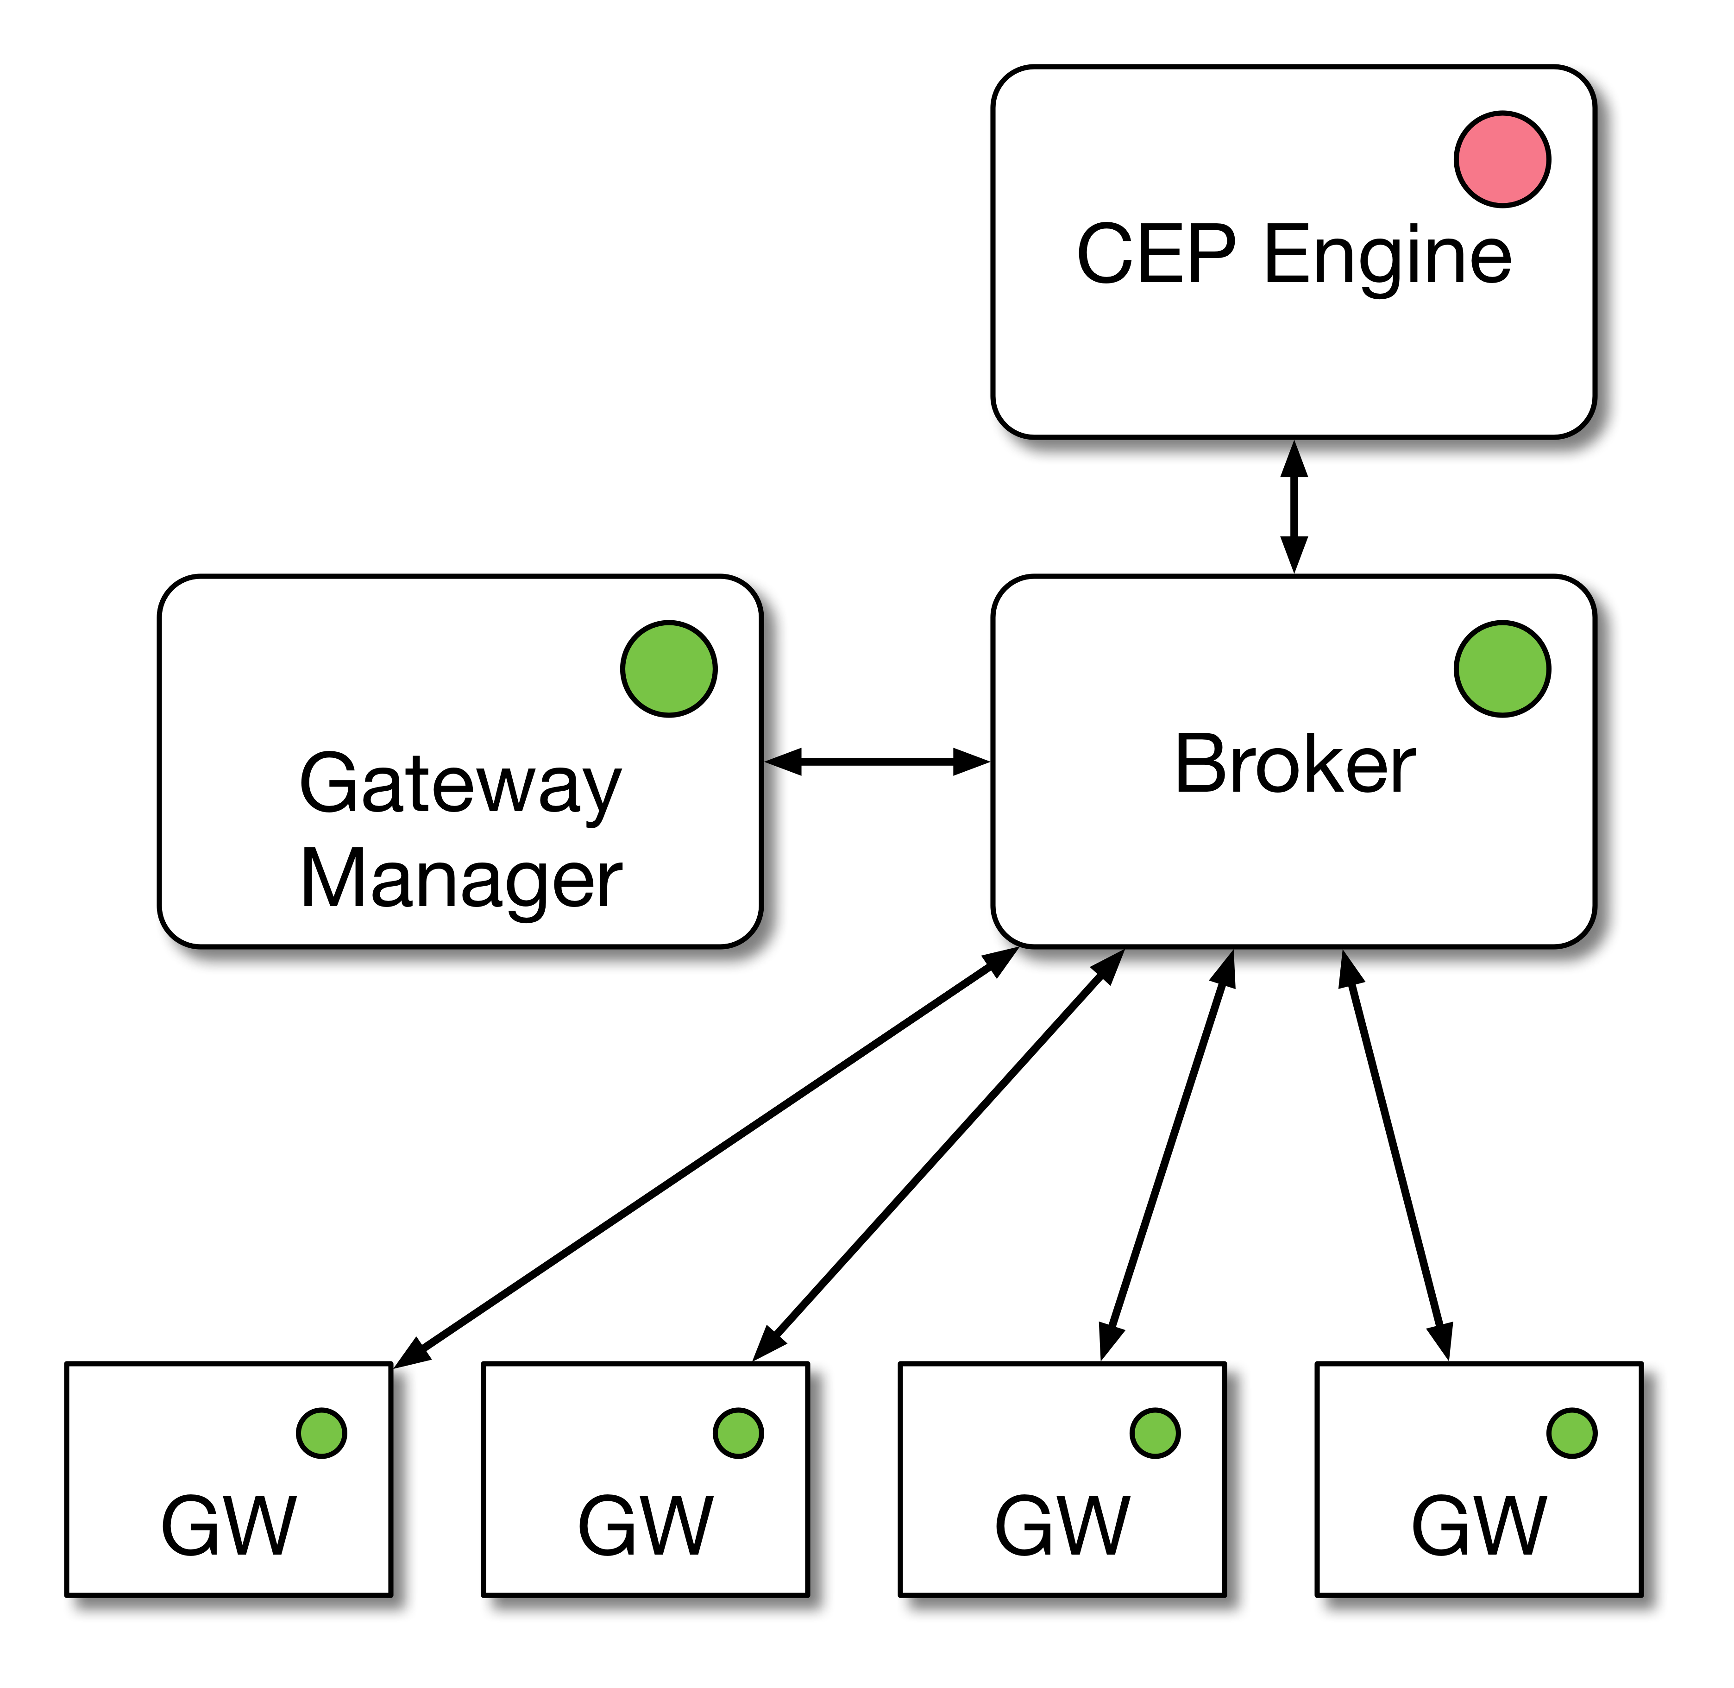
Operational Scenarios
SmartLighting Project
Building Automation with Failure Tolerance
Bernardo Ferreira
Scenario 1 - All components are operational
Scenario 2 - CEP Engine failure
Motivation & Objectives
Framework
SmartLighting Project
Implementation
Evaluation &
Results
Conclusion &
Future Work

Slide 21
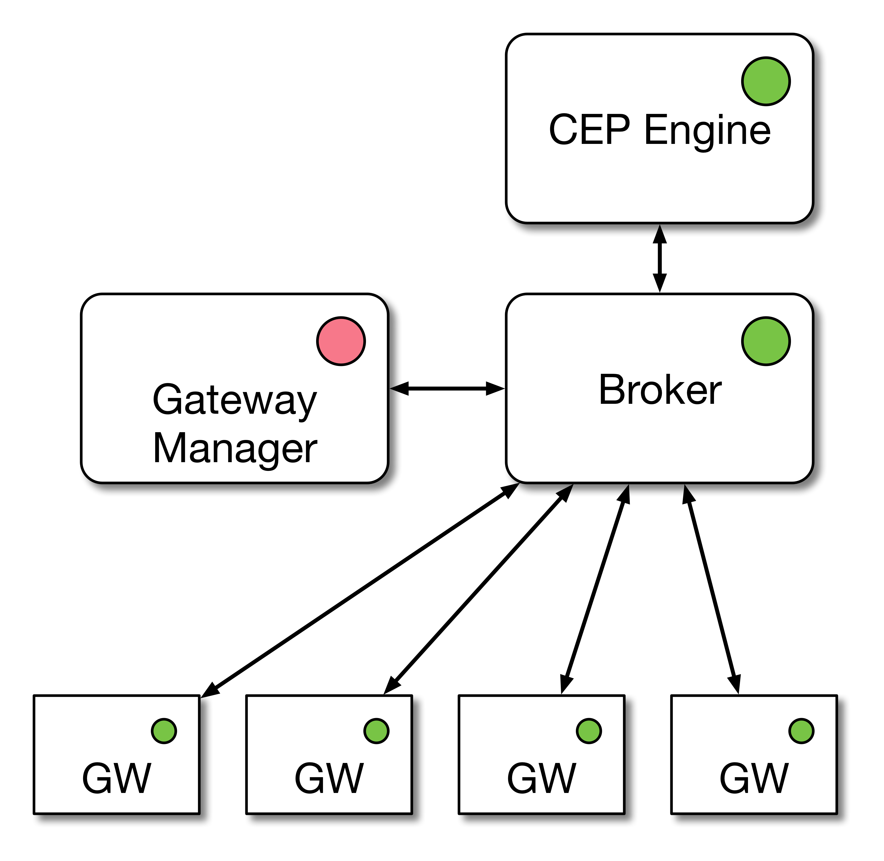
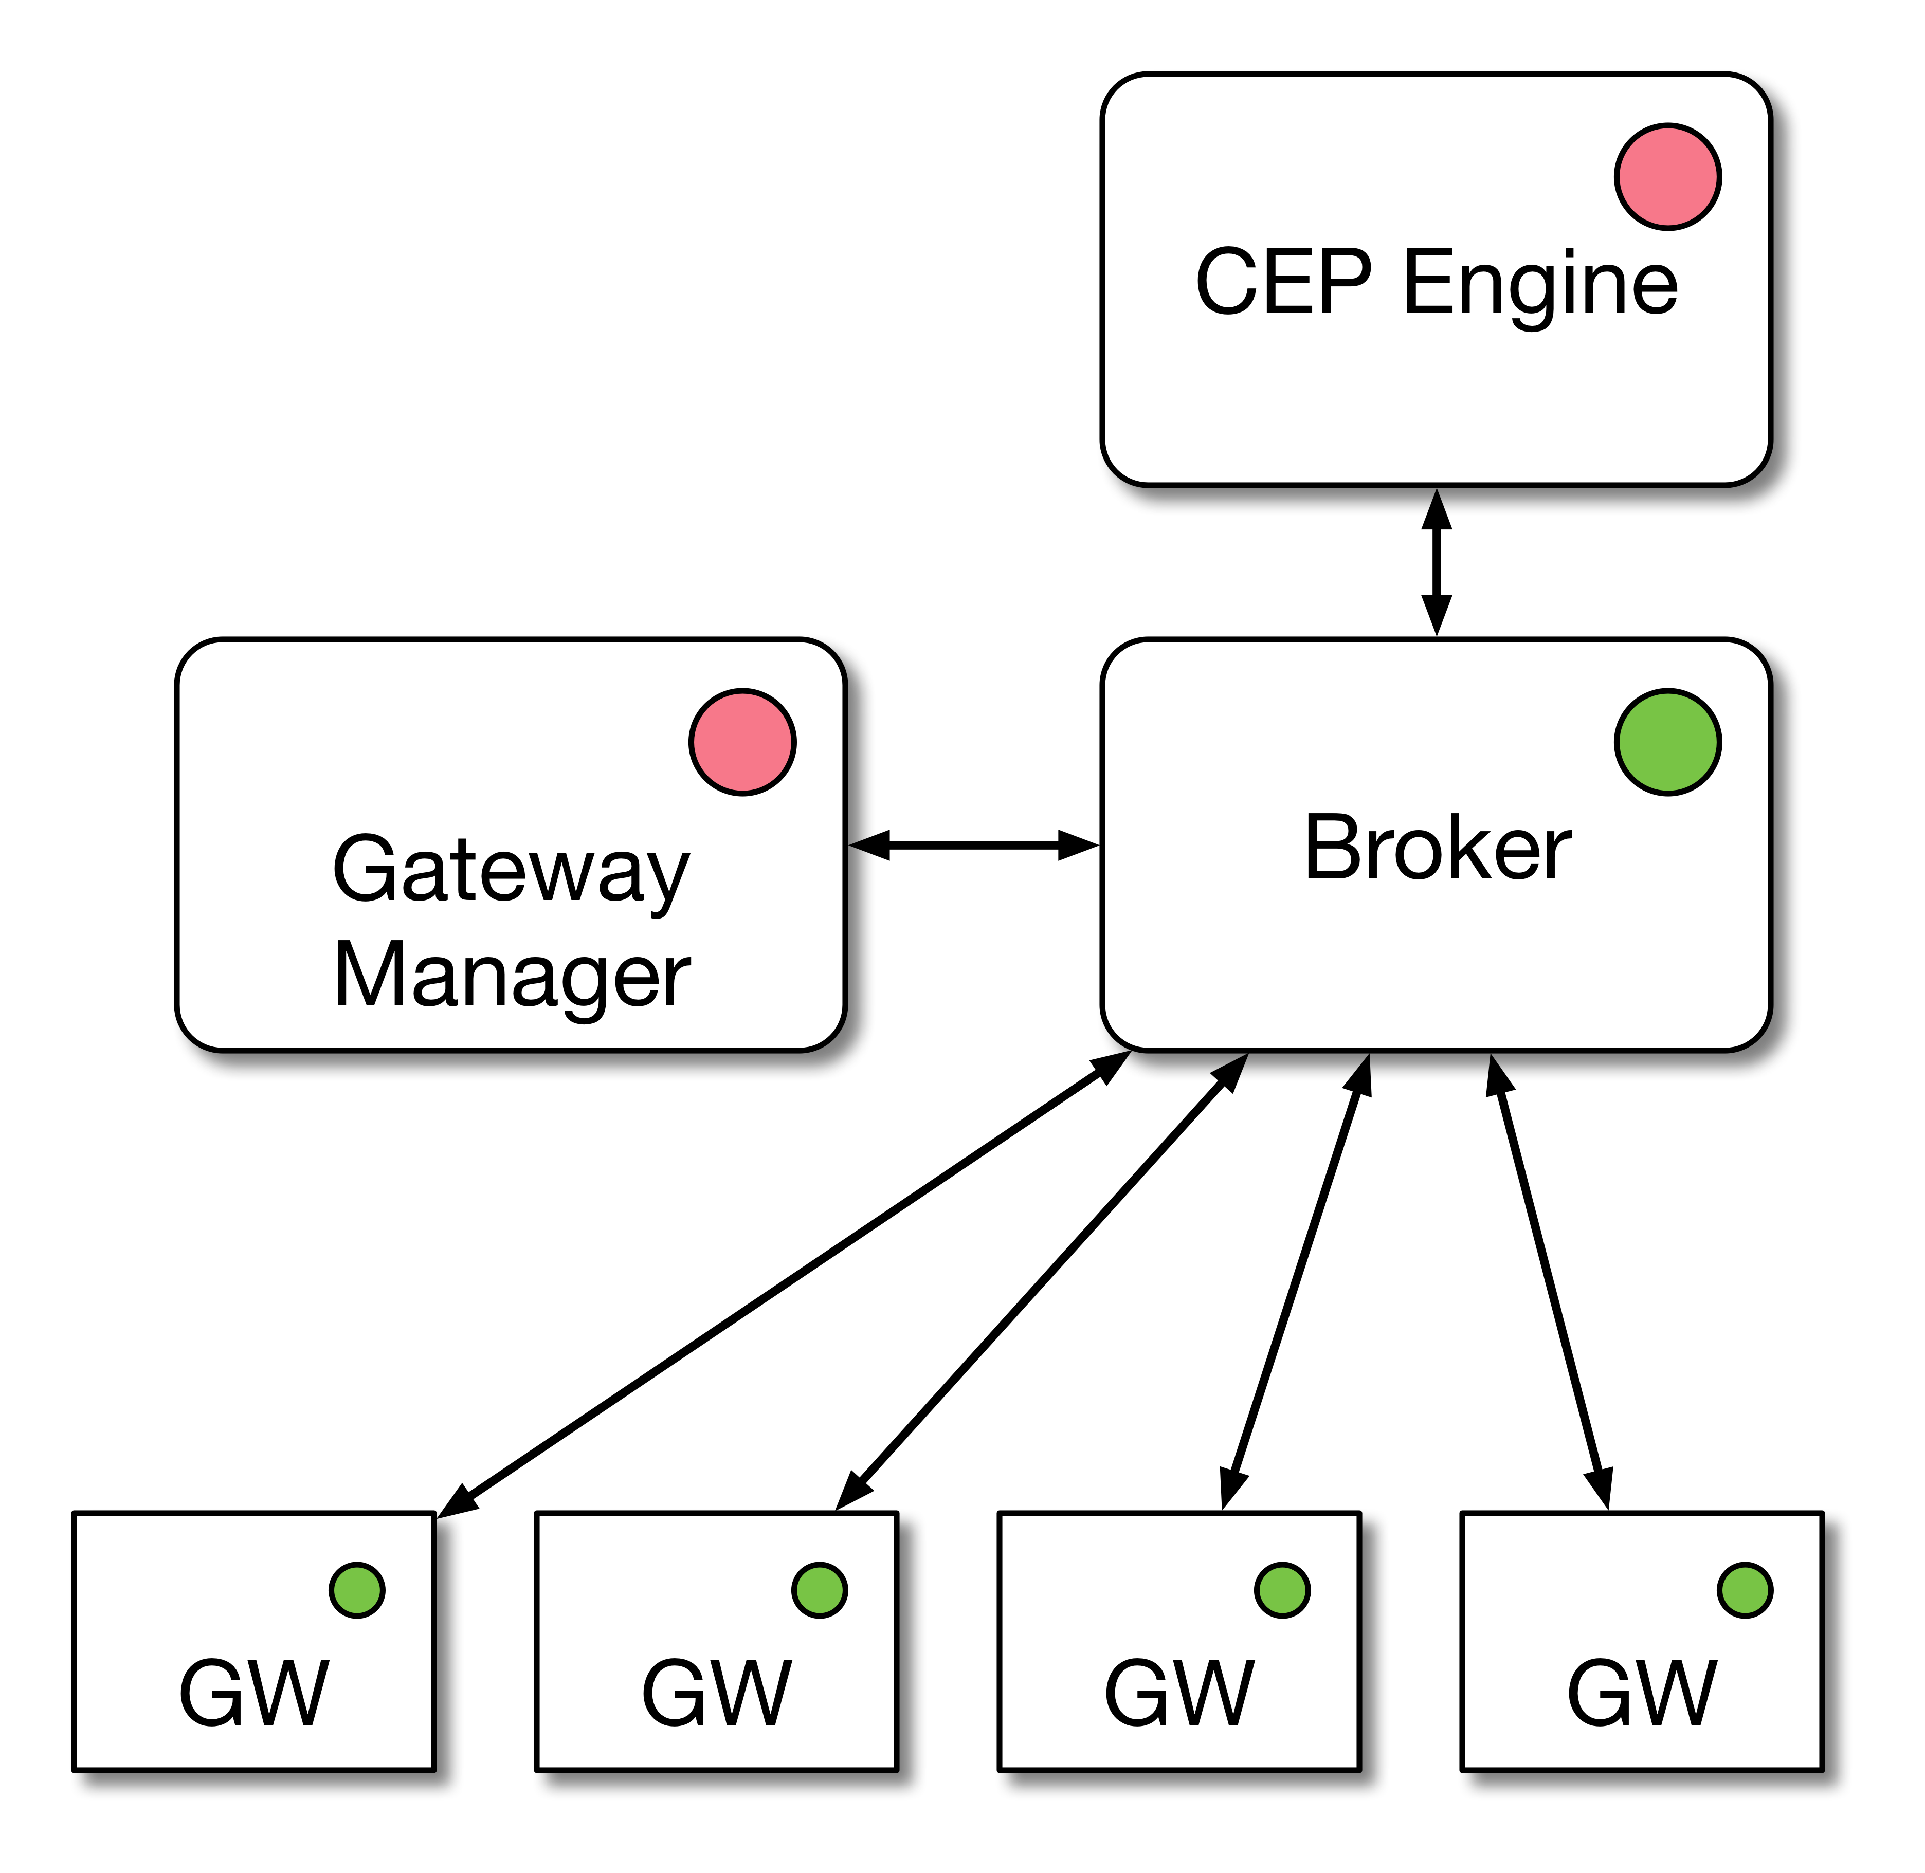
Operational Scenarios
SmartLighting Project
Building Automation with Failure Tolerance
Bernardo Ferreira
Scenario 3 – Gateway Manager Failure
Scenario 4 – Gateway Manager and CEP Engine failure
Motivation & Objectives
Framework
SmartLighting Project
Implementation
Evaluation &
Results
Conclusion &
Future Work

Slide 22
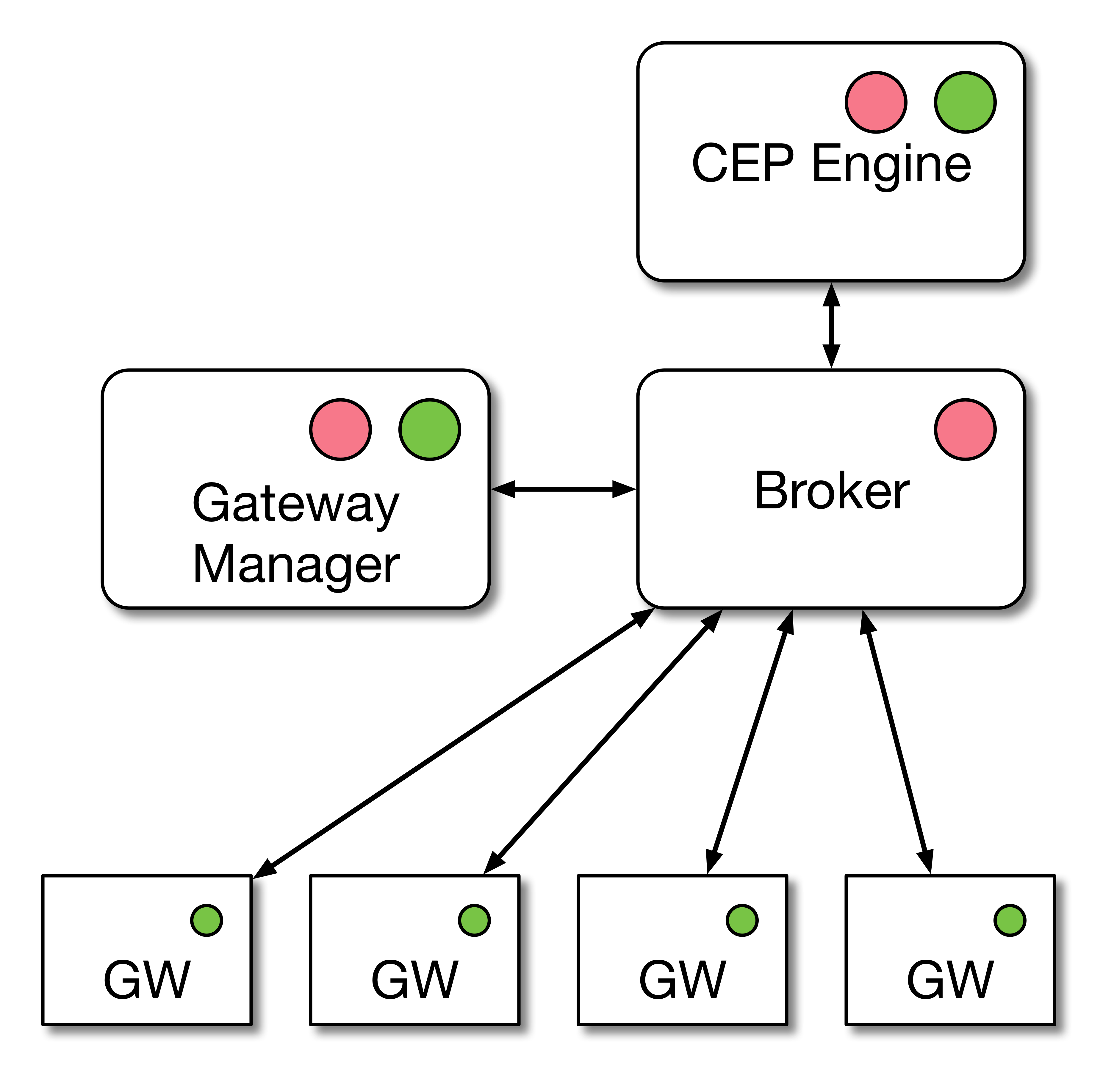
Operational Scenarios
SmartLighting Project
Building Automation with Failure Tolerance
Bernardo Ferreira
Scenario 5 – MQTT Broker failure
Motivation & Objectives
Framework
SmartLighting Project
Implementation
Evaluation &
Results
Conclusion &
Future Work

Slide 23
Implementation
Motivation & Objectives
Framework
SmartLighting
Project
Implementation
Evaluation & Results
Conclusion & Future Work

Slide 24
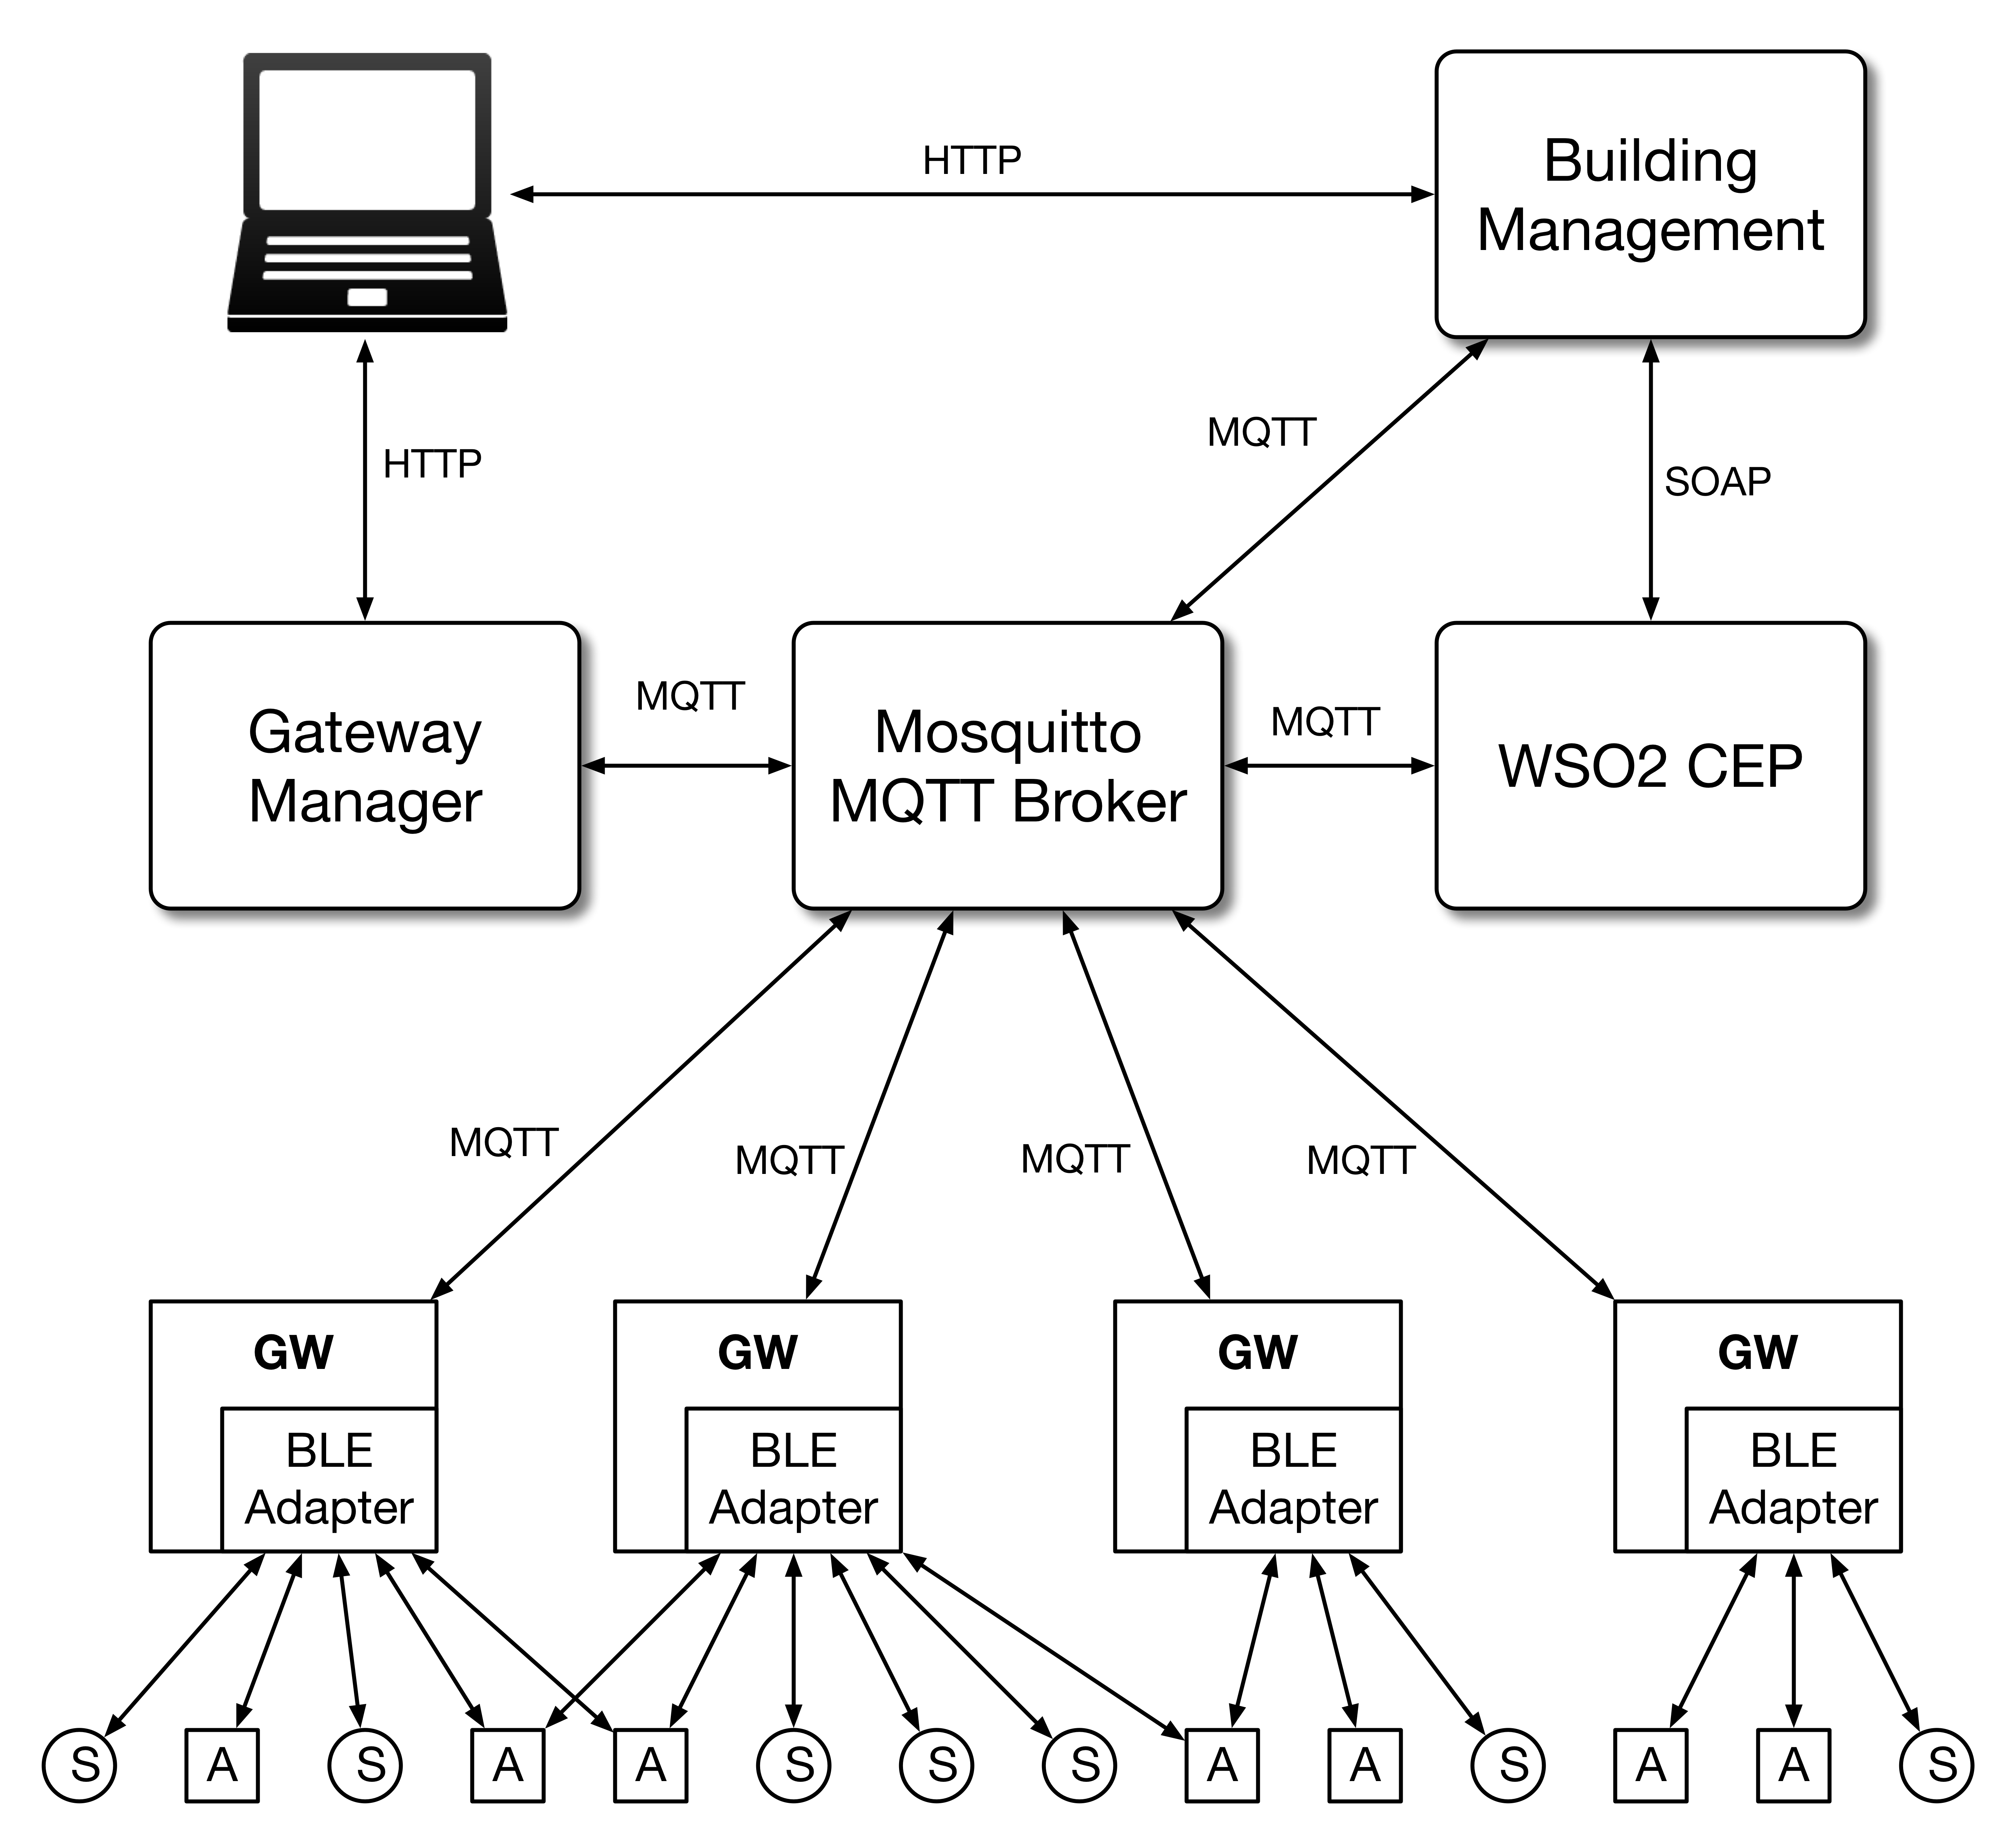
Architecture
Implementation
Building Automation with Failure Tolerance
Bernardo Ferreira
Motivation & Objectives
Framework
SmartLighting Project
Implementation
Evaluation &
Results
Conclusion &
Future Work
Notes:
tecnologias existentes

Slide 25
Gateway Manager
Implementation
Building Automation with Failure Tolerance
Bernardo Ferreira
Implemented using Python 3 and the Eclipse Paho MQTT Python client library.
Implemented Features:
Rule Parsing and Distribution;
System Awareness;
Devices configuration;
Gateway Manager Dashboard;
Gateway Failure Handling;
Gateways Synchronization.
Motivation & Objectives
Framework
SmartLighting Project
Implementation
Evaluation &
Results
Conclusion &
Future Work
Notes:
Tirar implemented featurees

Slide 26
Gateway Manager
Implementation
Building Automation with Failure Tolerance
Bernardo Ferreira
Rule Parsing and Distribution:
Receive rules from the Building Management, parse and divide the JSON into sub rules;
Distribute sub rules to available Gateways using a round-robin method.
Devices Configuration:
When a gateway connects to the system, publishes the devices within its range;
Balances and distribute the devices among the available gateways;
Uses a round-robin method.
Motivation & Objectives
Framework
SmartLighting Project
Implementation
Evaluation &
Results
Conclusion &
Future Work
Notes:
gm features

Slide 27
Gateway Manager
Implementation
Building Automation with Failure Tolerance
Bernardo Ferreira
System Awareness:
Subscribe to every component heartbeat MQTT topics;
Periodically checks if every component has sent the heartbeat message;
After 10 seconds without receiving an heartbeat from some component, begins implementing failure handling measures.
Gateway Failure Handling:
Checks which gateways have the lost devices within its range;
Distribute and inform gateways to take over those devices;
Redistribute rules among available gateways.
Motivation & Objectives
Framework
SmartLighting Project
Implementation
Evaluation &
Results
Conclusion &
Future Work
Notes:
mudar 4 ponto

Slide 28
Gateway Manager
Implementation
Building Automation with Failure Tolerance
Bernardo Ferreira
Gateways Synchronization:
Sends to gateways information regarding which rules and devices are controlled by each gateway.
Useful in Scenario 5.
Motivation & Objectives
Framework
SmartLighting Project
Implementation
Evaluation &
Results
Conclusion &
Future Work

Slide 29
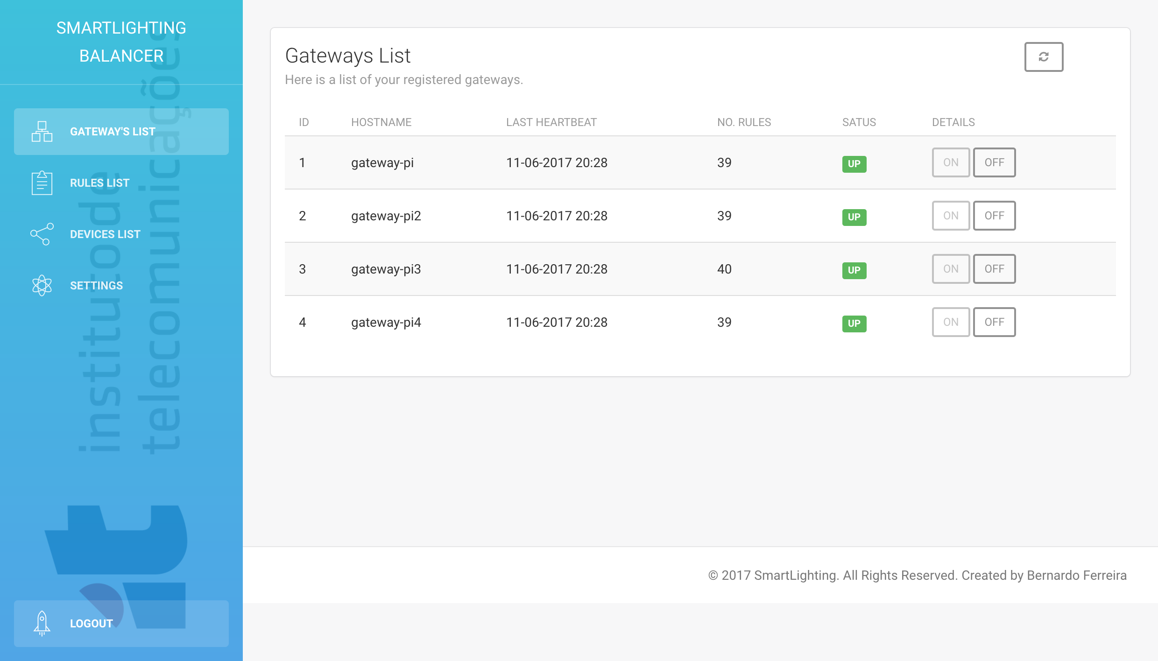
Gateway Manager
Implementation
Building Automation with Failure Tolerance
Bernardo Ferreira
Gateway Manager Dashboard:
Implemented using Flask;
Information about each gateway’s state;
Turn gateways on/off;
List of rules and its locations;
List of devices and which gateways control them;
Motivation & Objectives
Framework
SmartLighting Project
Implementation
Evaluation &
Results
Conclusion &
Future Work

Slide 30
Gateway
Implementation
Building Automation with Failure Tolerance
Bernardo Ferreira
Implemented using Micropython.
Avahi Multicast mDNS deamon.
Implemented Features:
Devices Configuration and Management;
Rule Parser;
Gateway Automation Engine.
Motivation & Objectives
Framework
SmartLighting Project
Implementation
Evaluation &
Results
Conclusion &
Future Work
Notes:
Micropython:
- Implementação eficiente do Python3 com apenas um subset da biblioteca de python. Otimizado para correr em microcontroladores

Slide 31
Gateway
Implementation
Building Automation with Failure Tolerance
Bernardo Ferreira
Devices Configuration and Management:
Gateways report available devices when connected;
The BM and GM respond with device’s publish topics;
Gateways subscribe to its device’s topics in the MQTT Broker;
Gateways start publishing events to the corresponding topics.
Rule Parser:
Parse sub rule sent by the Gateway Manager;
Create objects for each action specification;
Motivation & Objectives
Framework
SmartLighting Project
Implementation
Evaluation &
Results
Conclusion &
Future Work

Slide 32
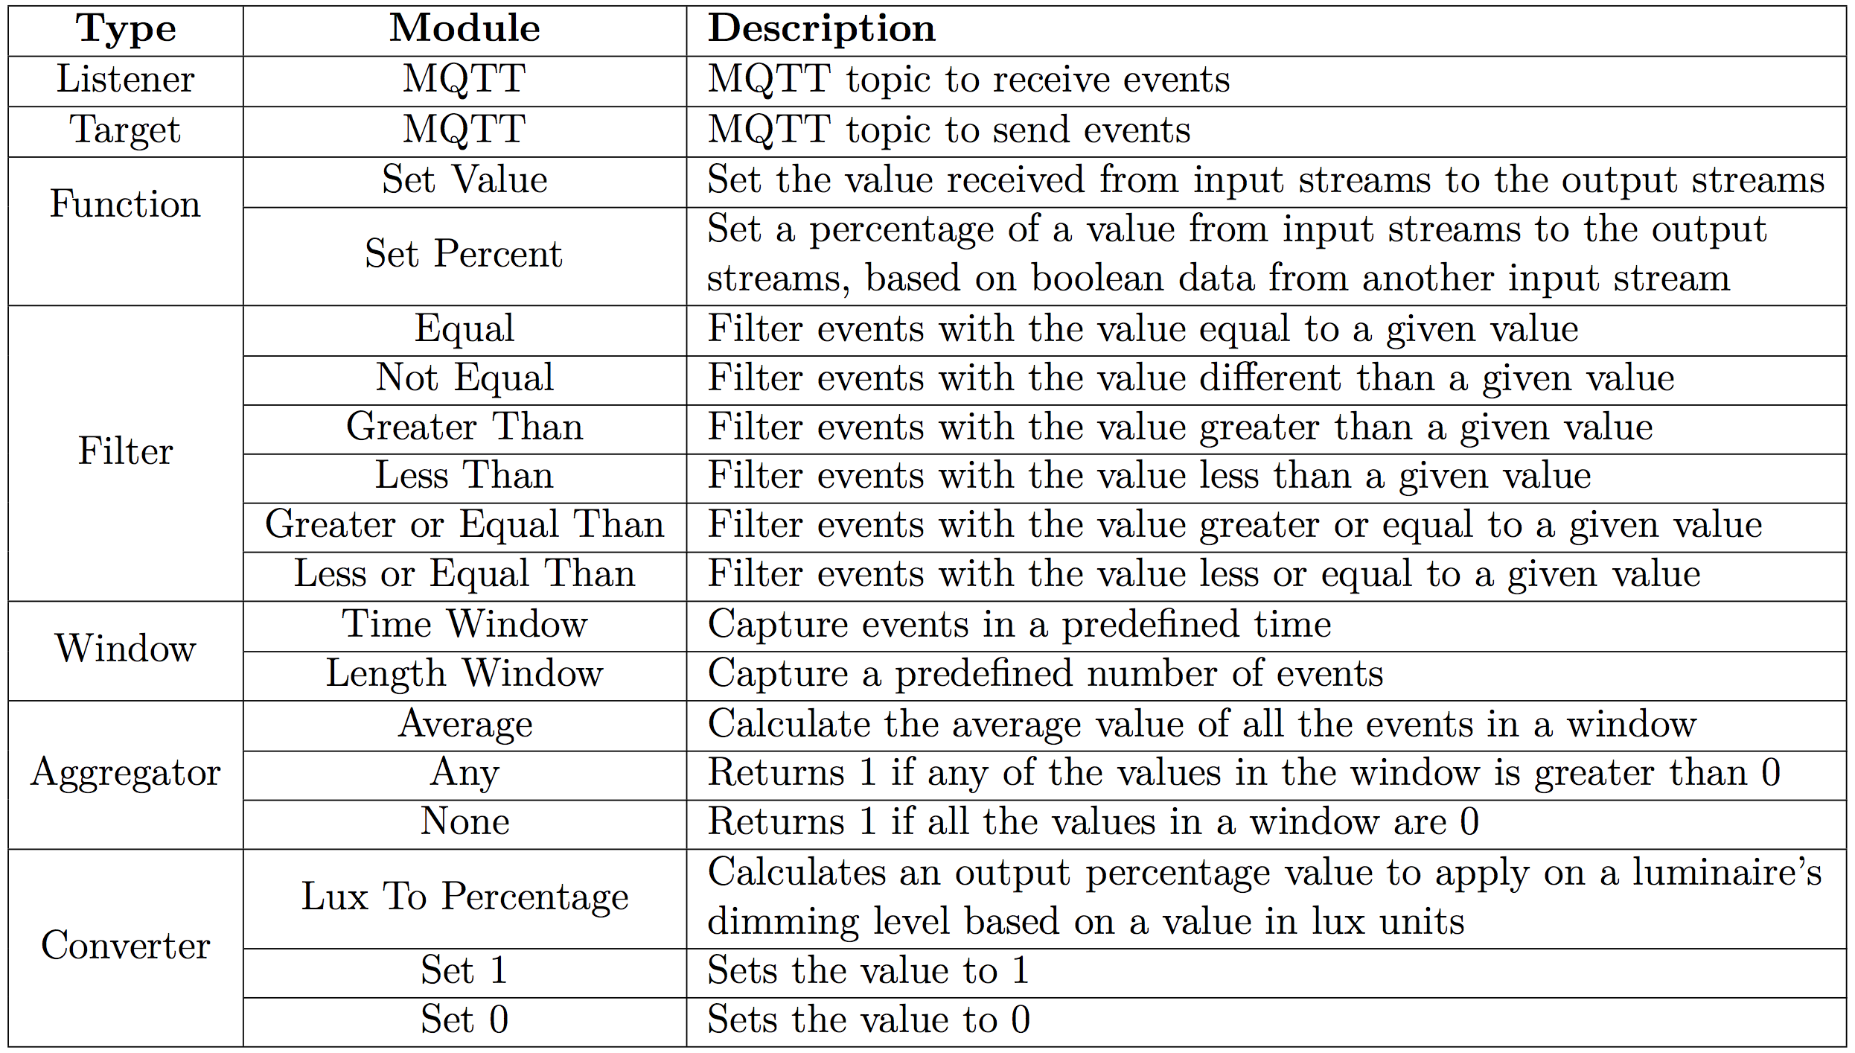
Gateway
Implementation
Building Automation with Failure Tolerance
Bernardo Ferreira
Gateway Automation Engine:
Function:
Set Value;
Set Percent;
Filter:
=, !=, >, <, >=, <=;
Window:
Time Window;
Length Window;
Aggregator:
Average;
Any
None
Converter:
Lux to Percent;
Set 1, Set 0;
Motivation & Objectives
Framework
SmartLighting Project
Implementation
Evaluation &
Results
Conclusion &
Future Work
Notes:
Implementadas janelas temporais
Janela de numero de eventos
Usadas com agregadores
Media, retorna 1 se um valor na window >1
Retorna 1 Se forem todos zero
Intensidade luminosa para percentagem
Colocar a um ou a 0

Slide 33
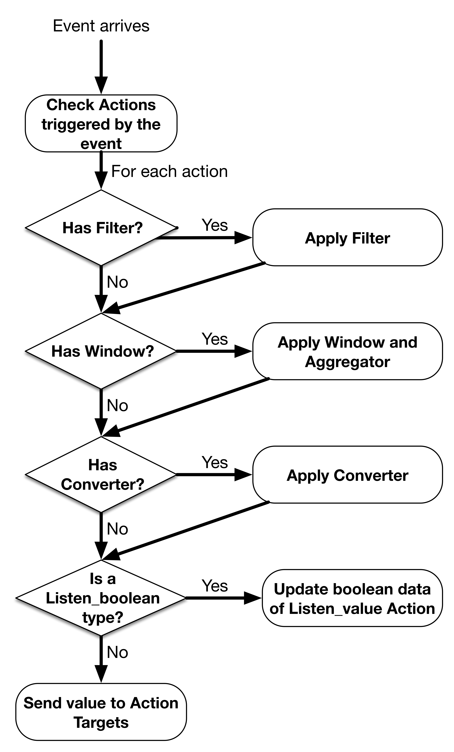
Gateway
Implementation
Building Automation with Failure Tolerance
Bernardo Ferreira
Gateway Automation Engine:
Check to which actions the event apply;
Process and send values to the target topics.
Motivation & Objectives
Framework
SmartLighting Project
Implementation
Evaluation &
Results
Conclusion &
Future Work

Slide 34
Operational Scenarios
Implementation
Building Automation with Failure Tolerance
Bernardo Ferreira
Scenario 1 - All components are operational
Gateways publish device events;
CEP Engine process events;
Gateway failure handling operational.
Motivation & Objectives
Framework
SmartLighting Project
Implementation
Evaluation &
Results
Conclusion &
Future Work
Notes:
Gateway – Broker - Cep
Gateways têm tolerancia a falhas

Slide 35
Operational Scenarios
Implementation
Building Automation with Failure Tolerance
Bernardo Ferreira
Scenario 2 - CEP Engine failure
Gateways publish device events;
Gateway’s automation engine process events;
Gateway failure handling operational.
Motivation & Objectives
Framework
SmartLighting Project
Implementation
Evaluation &
Results
Conclusion &
Future Work
Notes:
Gateway – Broker - Gateway

Slide 36
Operational Scenarios
Implementation
Building Automation with Failure Tolerance
Bernardo Ferreira
Scenario 3 – Gateway Manager Failure
Gateways publish device events;
CEP Engine process events;
Gateway failure handling disabled.
Motivation & Objectives
Framework
SmartLighting Project
Implementation
Evaluation &
Results
Conclusion &
Future Work
Notes:
Gateway – Broker – CEP
Gateways nao podem falhar

Slide 37
Operational Scenarios
Implementation
Building Automation with Failure Tolerance
Bernardo Ferreira
Scenario 4 – Gateway Manager and CEP Engine failure
Gateways publish device events;
Gateway’s automation engine process events;
Gateway failure handling disabled.
Motivation & Objectives
Framework
SmartLighting Project
Implementation
Evaluation &
Results
Conclusion &
Future Work
Notes:
Gateway – Broker – Gateway
GW nao podem falhar

Slide 38
Operational Scenarios
Implementation
Building Automation with Failure Tolerance
Bernardo Ferreira
Scenario 5 – MQTT Broker failure
Gateways publish device events directly to other gateways;
Gateway’s automation engine process events;
Gateway failure handling disabled.
Motivation & Objectives
Framework
SmartLighting Project
Implementation
Evaluation &
Results
Conclusion &
Future Work
Notes:
Gw – Gw
Nao há resolução de falhas

Slide 39
Evaluation & Results
Motivation & Objectives
Framework
SmartLighting
Project
Implementation
Evaluation & Results
Conclusion & Future Work

Slide 40
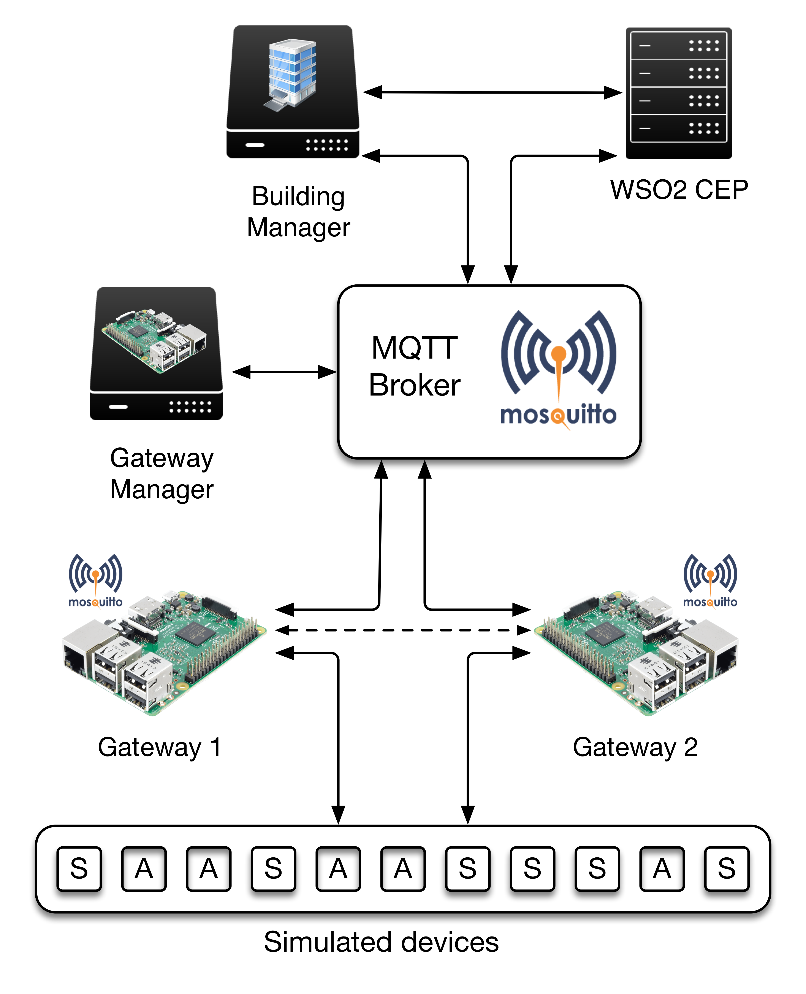
Deployment Scenario
Evaluation & Results
Building Automation with Failure Tolerance
Bernardo Ferreira
Deployment in IT Building internal network.
Virtual machine with Gateway Manager software and dashboard.
Virtual machine with Building Management.
Virtual machine with WSO2 CEP.
Mosquitto MQTT Broker.
Two Raspberry Pi 3 as Gateways.
Motivation & Objectives
Framework
SmartLighting Project
Implementation
Evaluation &
Results
Conclusion &
Future Work
Notes:
Virtula machines:
xxx
xxx
xxx
xx

Slide 41
Performance Results
Evaluation & Results
Building Automation with Failure Tolerance
Bernardo Ferreira
Gateway Automation Engine Performance
Stress test:
Measure the time to process 1, 10, 100, 1000 and 10000 consecutive events.
10 runs each.
Motivation & Objectives
Framework
SmartLighting Project
Implementation
Evaluation &
Results
Conclusion &
Future Work
Notes:
Medido o tempo desde o envio do primeiro evento até a receção da ultima resposta

Slide 42
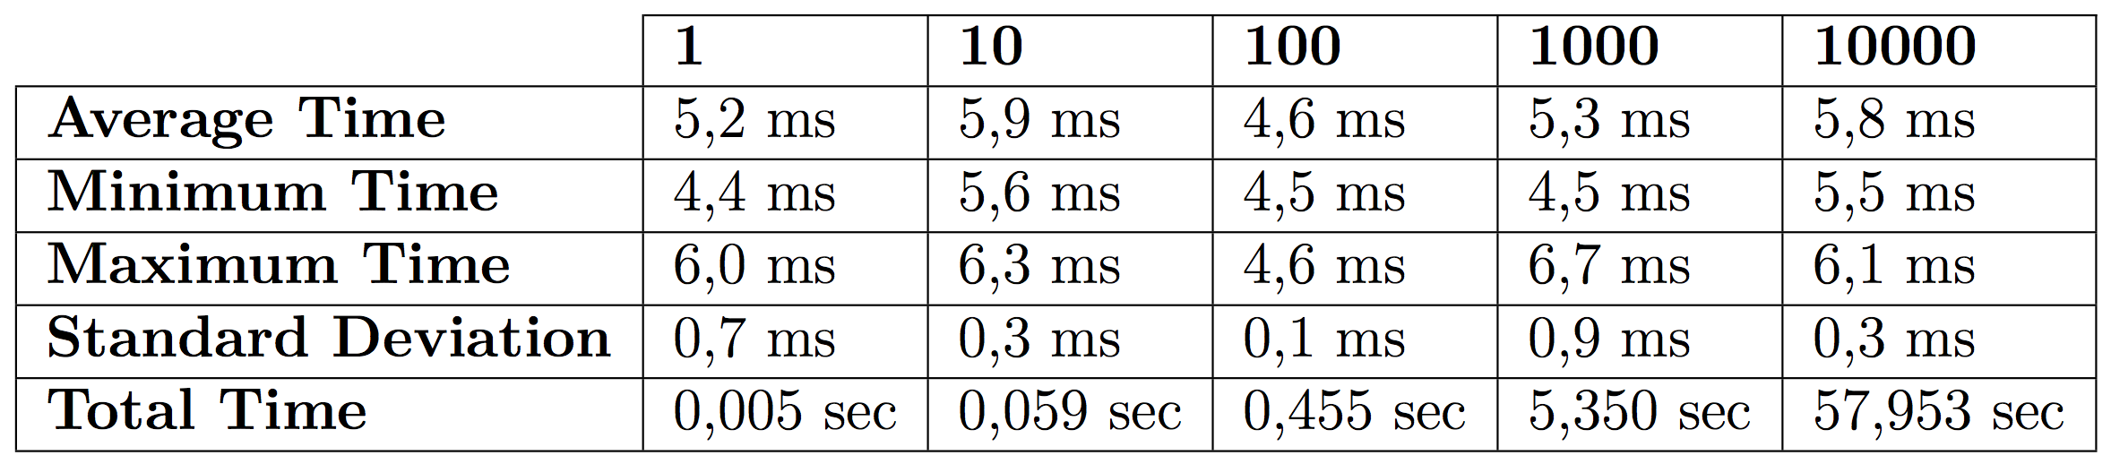
Performance Results
Evaluation & Results
Building Automation with Failure Tolerance
Bernardo Ferreira
Average of 4 to 6 ms to process a single event.
CPU usage:
Idle: 1 core 100%
10000 events: 100% core 1
16% core 2
Motivation & Objectives
Framework
SmartLighting Project
Implementation
Evaluation &
Results
Conclusion &
Future Work
Notes:
previsivel
Idle a 100 por causa do event loop do micropython.
Não suporta threads

Slide 43
Performance Results
Evaluation & Results
Building Automation with Failure Tolerance
Bernardo Ferreira
Gateway Reaction Time
Reaction time to a failure in the CEP Engine.
Disable the CEP Engine.
Measure the time needed for a Gateway to start processing events.
Reaction time to a Gateway Failure.
Two Gateways with the same devices sending heartbeats in 5 second intervals.
Disable Gateway 1.
Measure Gateway’s 2 reaction time and later Gateway’s 1 recovery time.
Motivation & Objectives
Framework
SmartLighting Project
Implementation
Evaluation &
Results
Conclusion &
Future Work
Notes:
Por os intervalos em cima

Slide 44
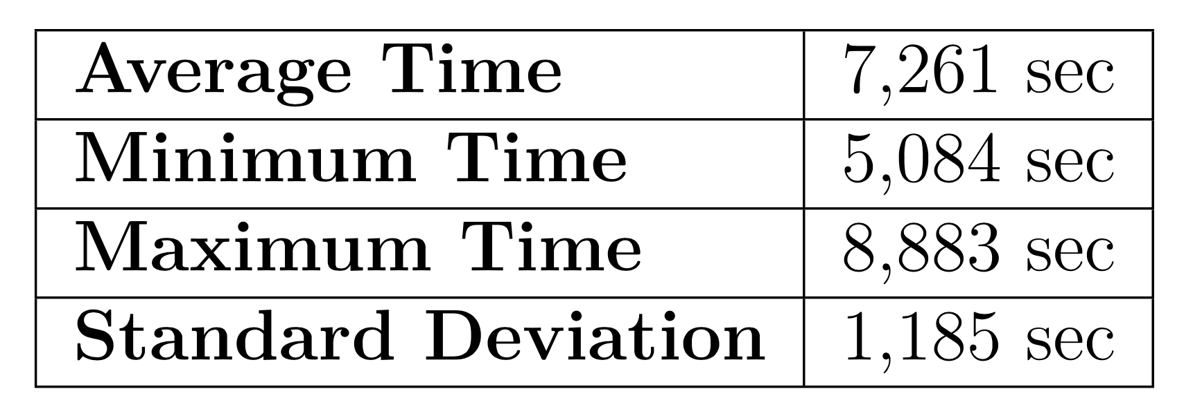
Performance Results
Evaluation & Results
Building Automation with Failure Tolerance
Bernardo Ferreira
Failure in the CEP Engine.
Gateways wait 5 seconds before conclude that the CEP Engine is unreachable
10 runs.
Average of 7.3 sec of reaction time.
Motivation & Objectives
Framework
SmartLighting Project
Implementation
Evaluation &
Results
Conclusion &
Future Work
Notes:
cep envia um em um sec

Slide 45
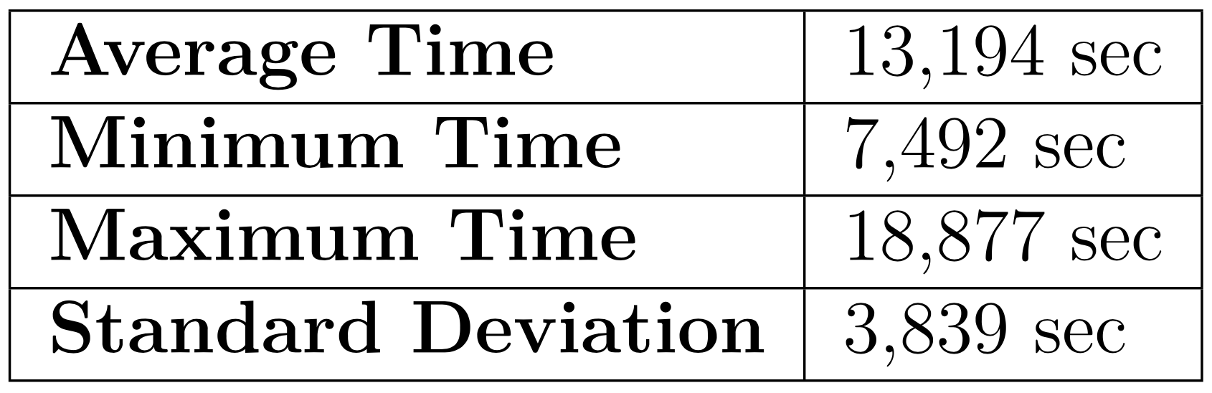
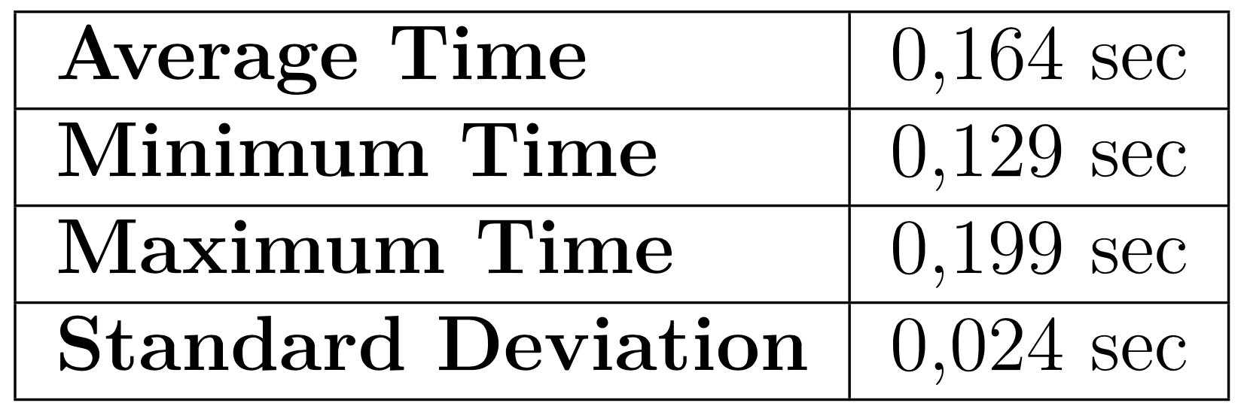
Performance Results
Evaluation & Results
Building Automation with Failure Tolerance
Bernardo Ferreira
Reaction to a failure.
Recovery from a failure.
10 runs.
Average of 13.2 sec of reaction time.
10 runs.
Average of 164 ms of recovery time.
Motivation & Objectives
Framework
SmartLighting Project
Implementation
Evaluation &
Results
Conclusion &
Future Work
Notes:
Desde que a GW é desligada,
Até os seus despositivos serem controlados por outra gateway
GW 5 em 5 a mandar para o GM
GM 10 em 10 a verificar se falhou

Slide 46
Conclusion & Future Work
Motivation & Objectives
Framework
SmartLighting
Project
Implementation
Evaluation & Results
Conclusion & Future Work

Slide 47
Conclusion
Conclusion & Future Work
Building Automation with Failure Tolerance
Bernardo Ferreira
The proposed objectives were achieved;
Failure handling of different operational scenarios;
Modular and lightweight solution.
Some problems found:
Handle of Gateway’s failures dependent on the Gateway Manager’s state;
Micropython’s limitations.
Motivation & Objectives
Framework
SmartLighting Project
Implementation
Evaluation &
Results
Conclusion &
Future Work
Notes:
Micropython ter algumas limitaçoes e nao ter sido feita uma implementação mais eficiente.
Falha num componente consegue ser remediada com o minimo de consequencias para os ocupantes

Slide 48
Future Work
Conclusion & Future Work
Building Automation with Failure Tolerance
Bernardo Ferreira
Persistence;
Security;
Implement service discovery in Gateways;
Extend Gateway’s Automation Engine modules.
Motivation & Objectives
Framework
SmartLighting Project
Implementation
Evaluation &
Results
Conclusion &
Future Work

Slide 49
Building Automation with Failure Tolerance
Automação de Edifícios com Tolerância a Falhas
Bernardo Ferreira
Supervisor: Prof. Dr. João Paulo Barraca
Co-supervisor: Mestre Nuno Lourenço
Examiner: Prof. Dr. Jorge Sá Silva
Dissertação de Mestrado Integrado em Engenharia de Computadores e Telemática
Aveiro, 20 Dezembro de 2017

Slide 50
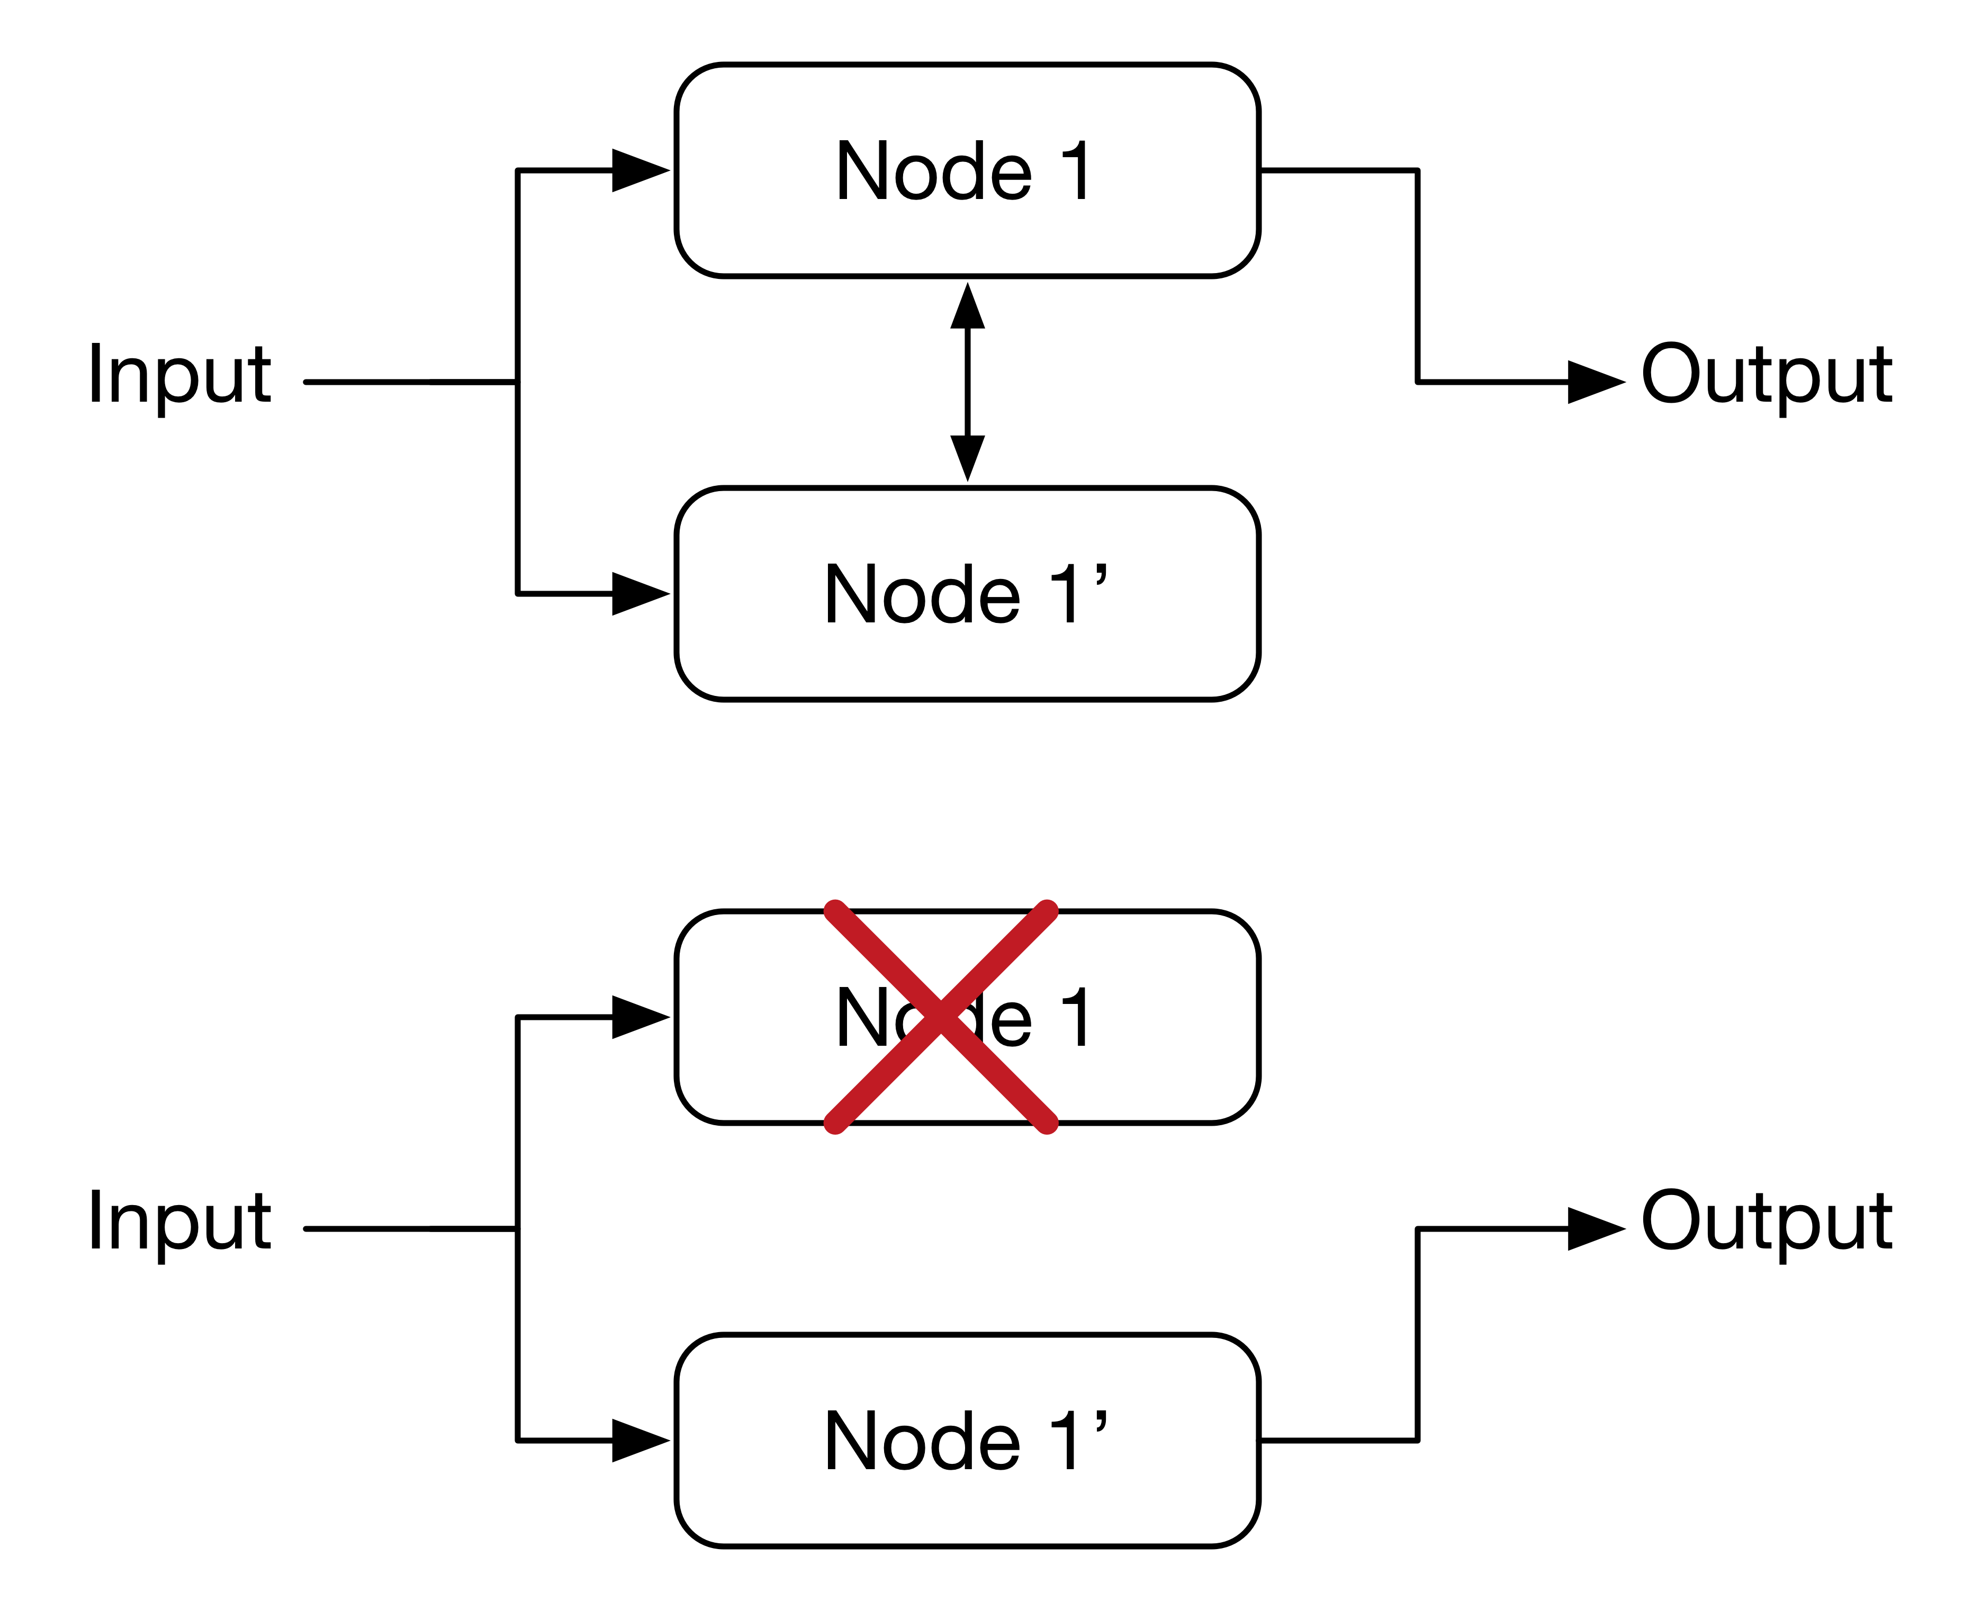
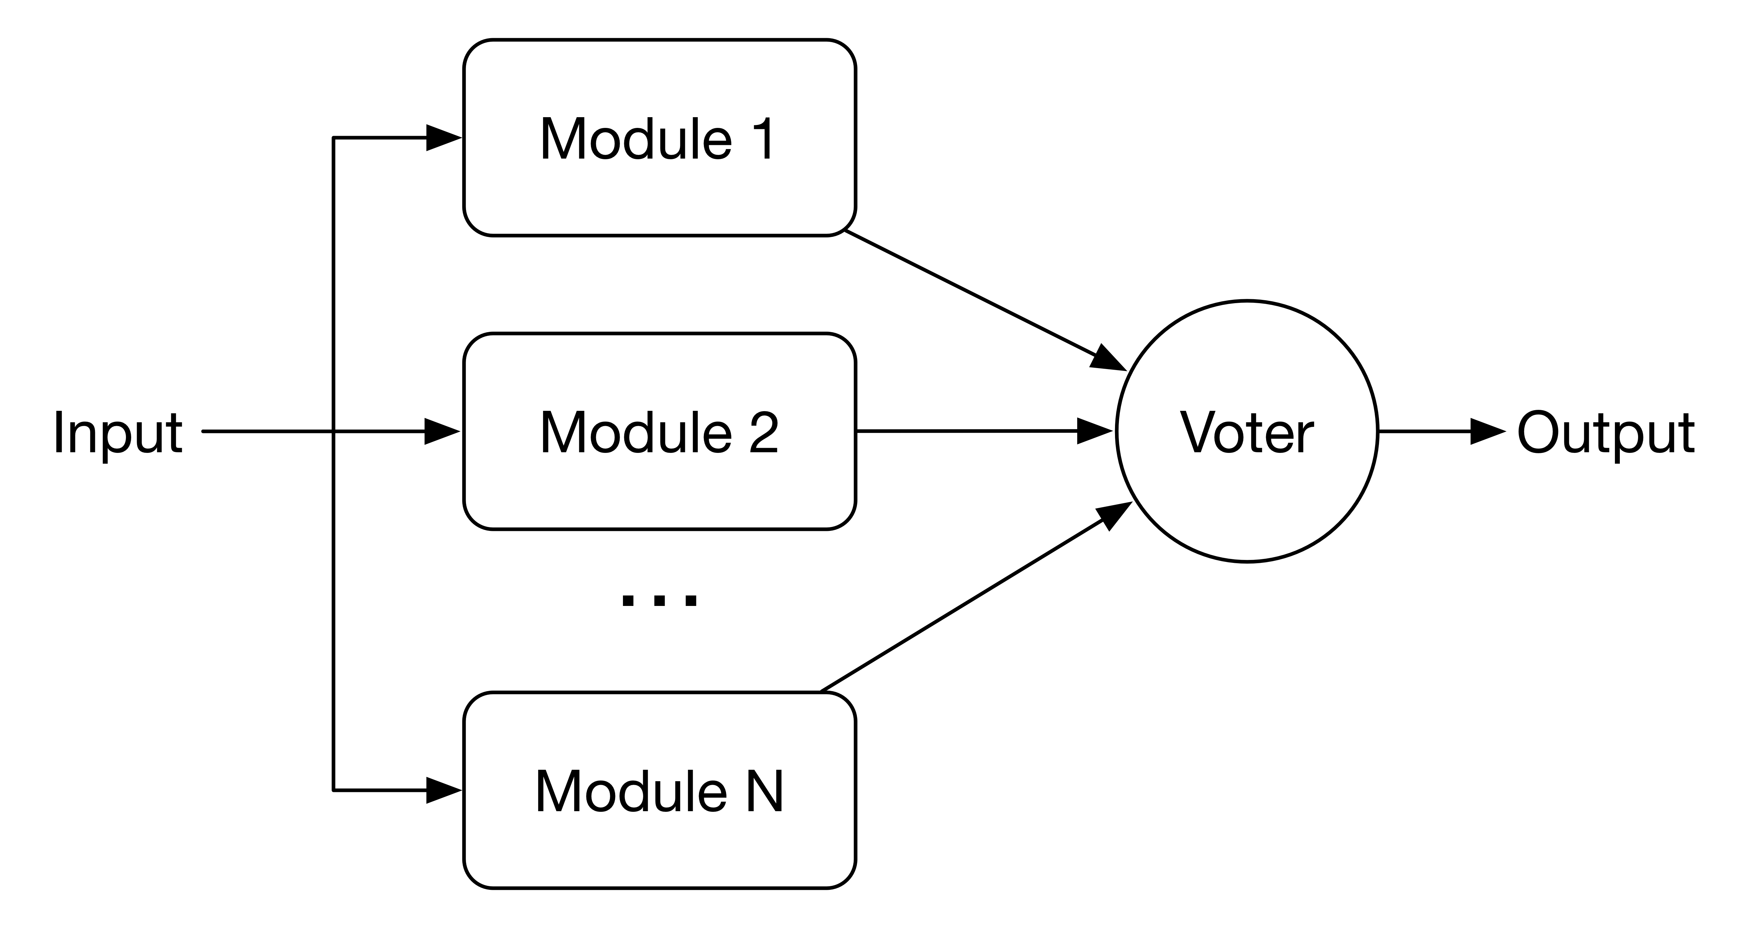
Fault Recovery Techniques
Framework
Building Automation with Failure Tolerance
Bernardo Ferreira
Hot standby redundancy.
N Modular redundancy.
Motivation & Objectives
Framework
SmartLighting Project
Implementation
Evaluation &
Results
Conclusion &
Future Work
Notes:
tiro

Slide 51
References
[1] Moreira, H. “Sensor Data Integration and Management of Smart Environments.” 2016.

Slide 52
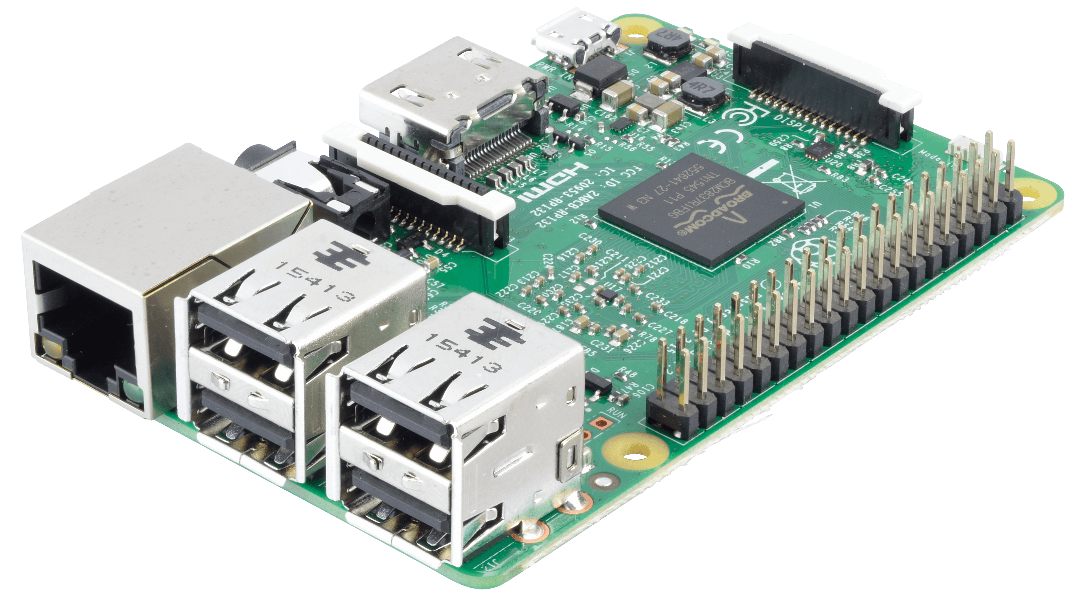
Hardware Device
Framework
Building Automation with Failure Tolerance
Bernardo Ferreira
Gateway hardware
Raspberry Pi 3 Model B;
Quad Core 1.2GHz 64bit ARM CPU;
1GB RAM;
Others: Nano Pi, VoCore, CloudBit etc..
Motivation & Objectives
Framework
SmartLighting Project
Implementation
Evaluation &
Results
Conclusion &
Future Work
Notes:
tirar

Slide 53
Requirements
SmartLighting Project
Building Automation with Failure Tolerance
Bernardo Ferreira
Fast Responsiveness;
Flexibility;
Scalability;
Failure Handling and Basic Functionalities;
Data Correlation;
User Control and User-Friendly Interfaces.
Motivation & Objectives
Framework
SmartLighting Project
Implementation
Evaluation &
Results
Conclusion &
Future Work

Slide 54
Gateway
Implementation
Building Automation with Failure Tolerance
Bernardo Ferreira
Rule Parser:
Parse sub rule sent by the Gateway Manager;
Create objects for each action specification;
Motivation & Objectives
Framework
SmartLighting Project
Implementation
Evaluation &
Results
Conclusion &
Future Work
Notes:
Este para a frente
tirar

Slide 55
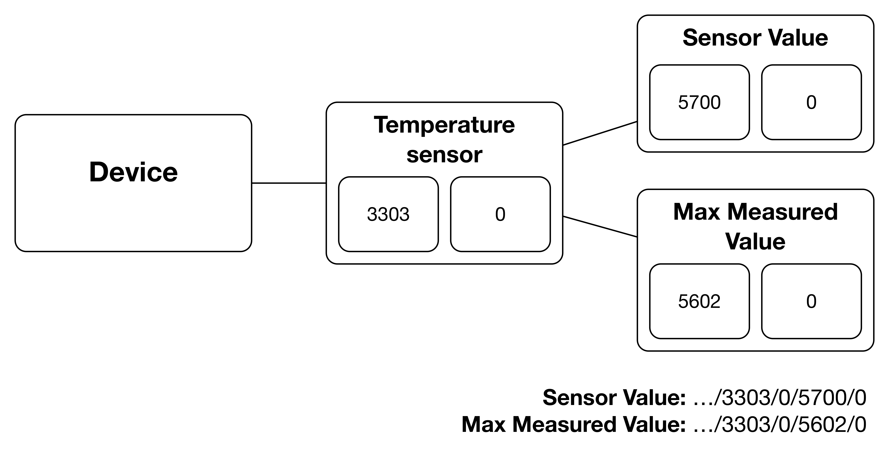
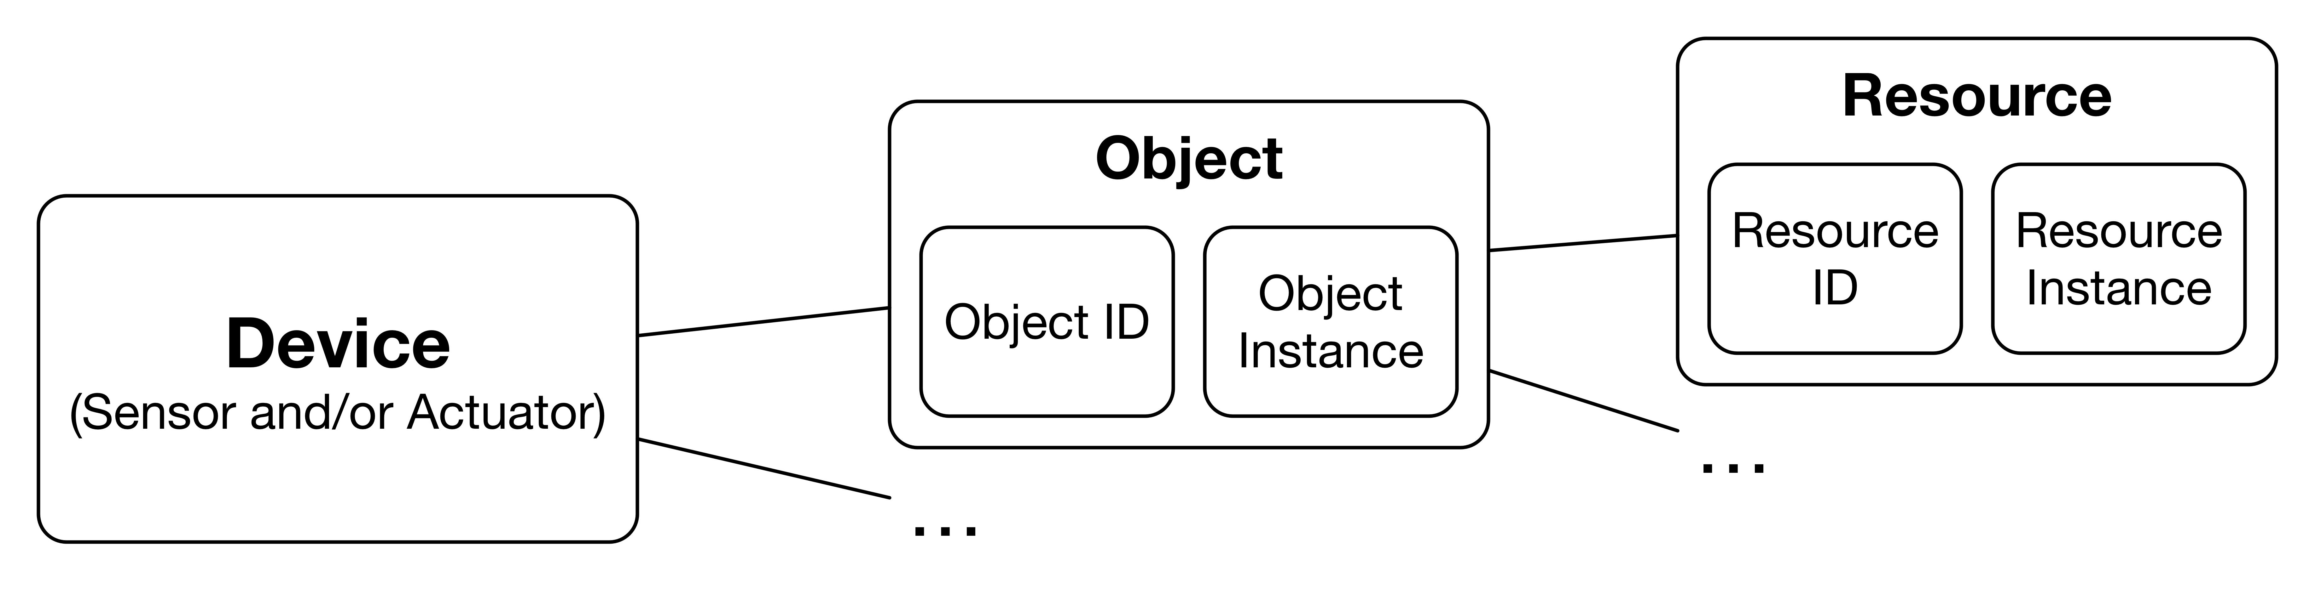
Access to Devices
SmartLighting Project
Building Automation with Failure Tolerance
Bernardo Ferreira
IP Smart Objects Alliance Guidelines
Each Device can have multiple objects.
Each Object can have multiple Resources.
Access URI:
/Building/Floor/RoomType/Room/Area/Device/Obj.ID/Obj.Instance/Res.ID/Res.Instance
Motivation & Objectives
Framework
SmartLighting Project
Implementation
Evaluation &
Results
Conclusion &
Future Work

